Slide 1

CSC 533: Privacy in the Digital Age (Fall 2020) Lecture 18: Privacy Notice
Anupam Das
Oct. 20, 2020

Slide 2
Goals for today
Various privacy notice format
Privacy notice design space
Evaluating effectiveness of various privacy notice design
Some slide contents have been taken from Lorrie Cranor

Slide 3
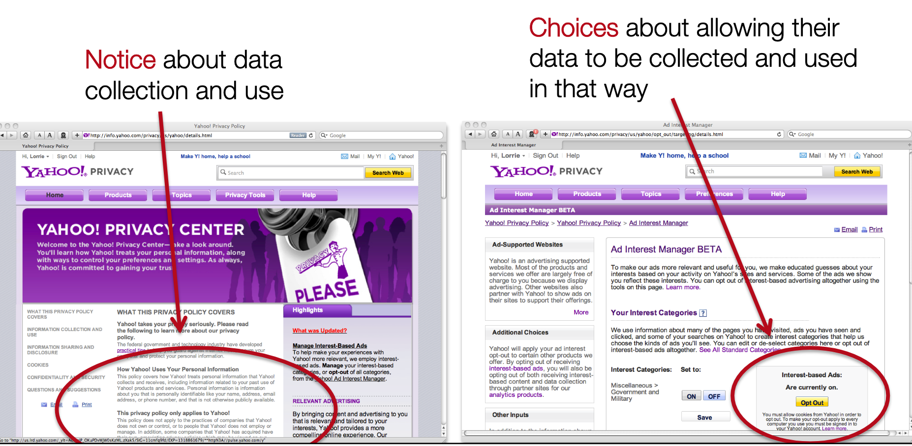
Privacy notice and choice
Protect privacy by giving people control over their information

Slide 4

Nobody reads policies
“the notice-and-choice model, as implemented, has led to long, incomprehensible privacy policies that consumers typically do not read, let alone understand”−
Protecting Consumer Privacy in an Era of Rapid Change. Preliminary FTC Staff Report. December 2010

Slide 5
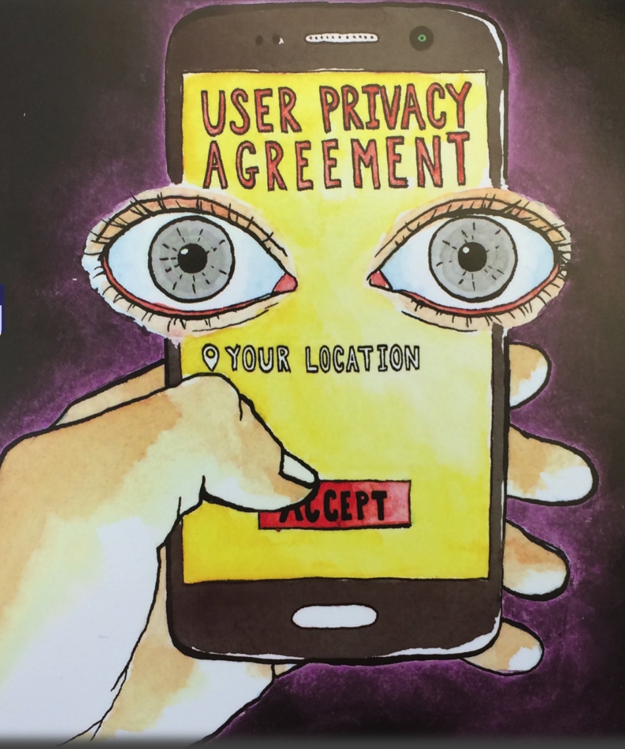
Notice fatigue and helplessness
Information shown at inopportune times
Misconceptions
Lack of understanding
Lack of choices
Habituation

Slide 6
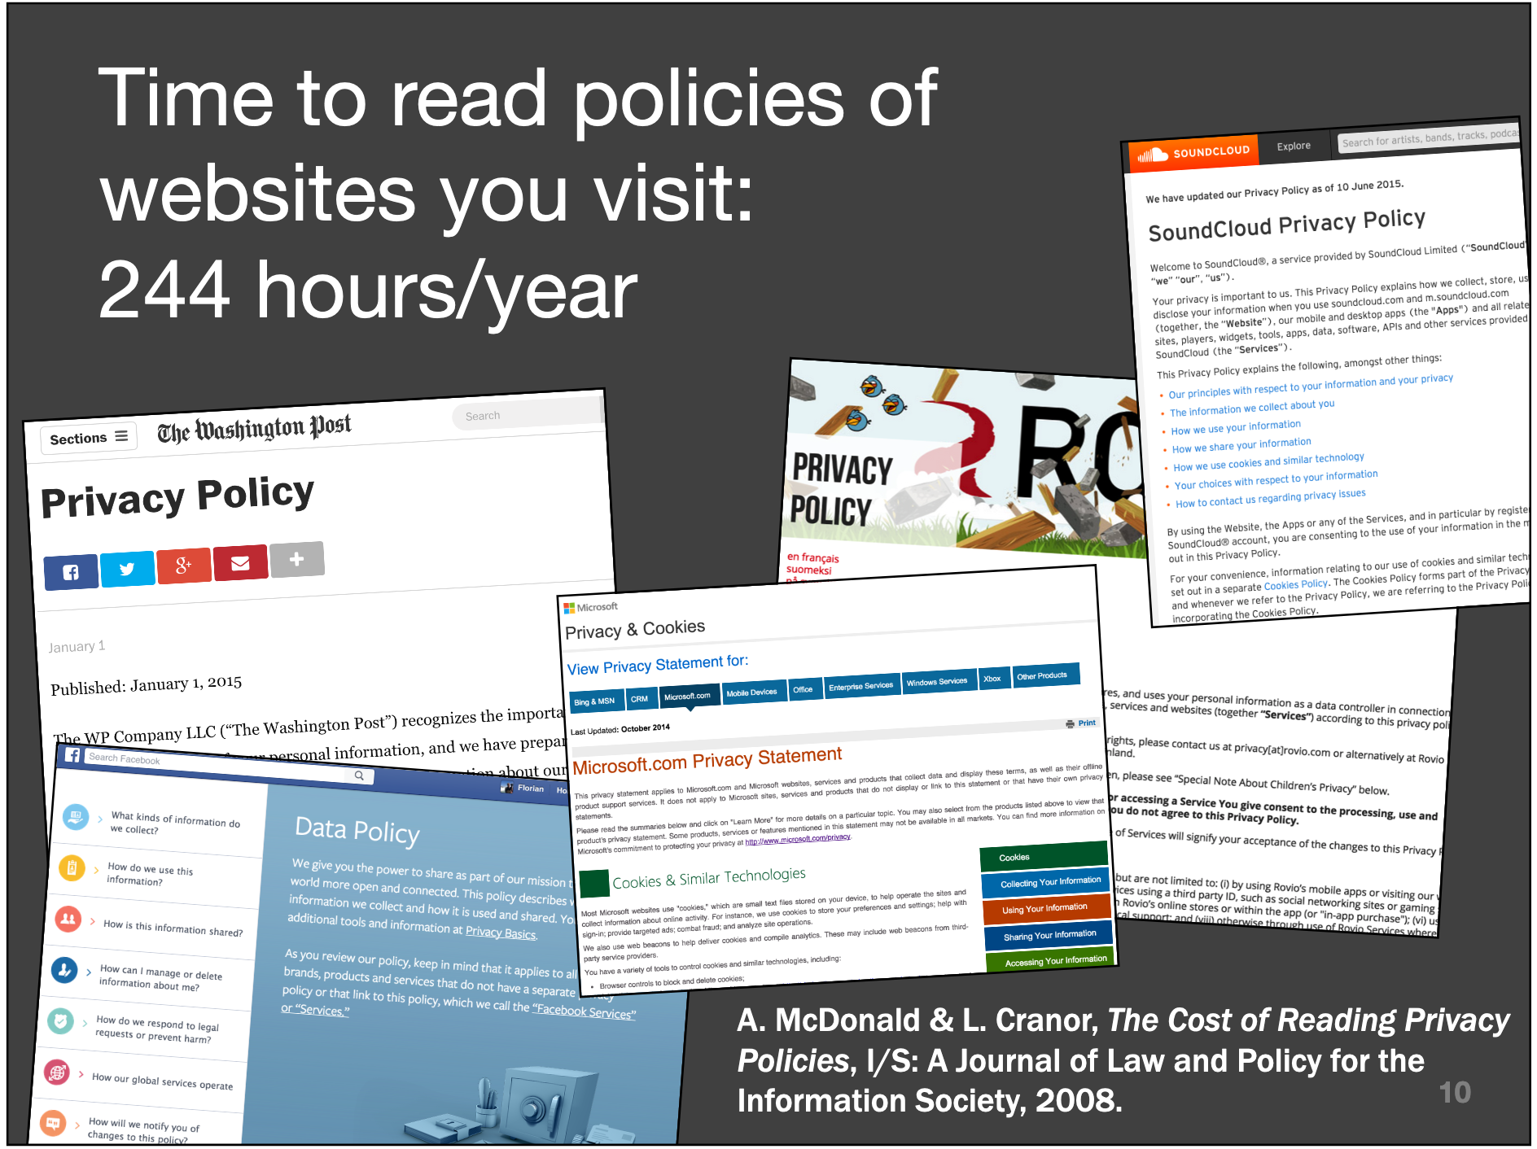
What if we read policies?
If every Internet user read privacy policies for each site they visited, it would cost $781 billion per year

Slide 7
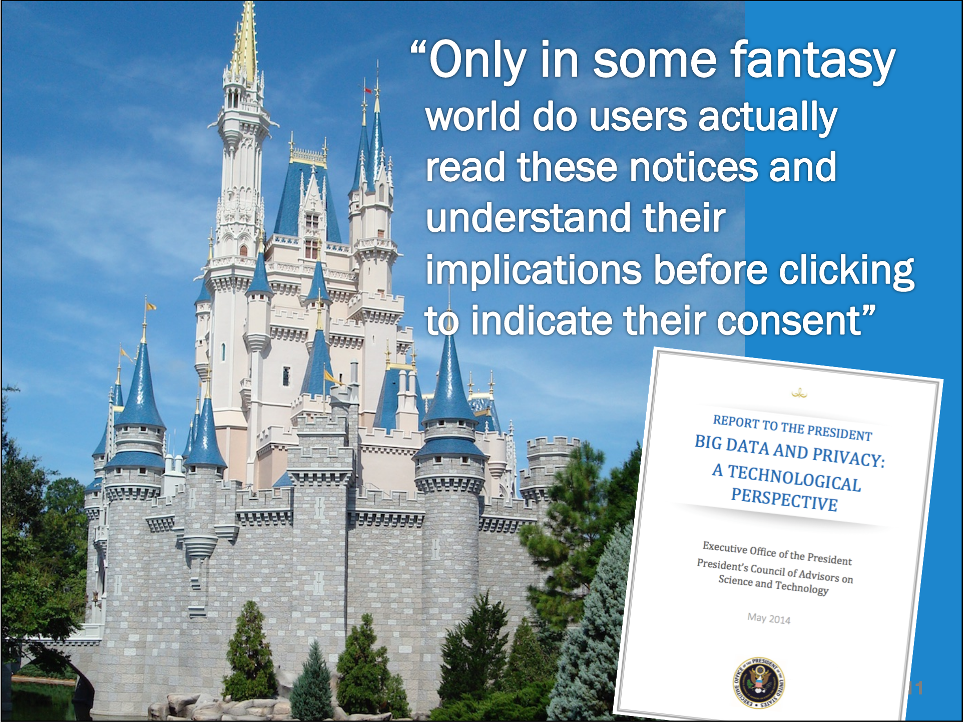

Slide 8
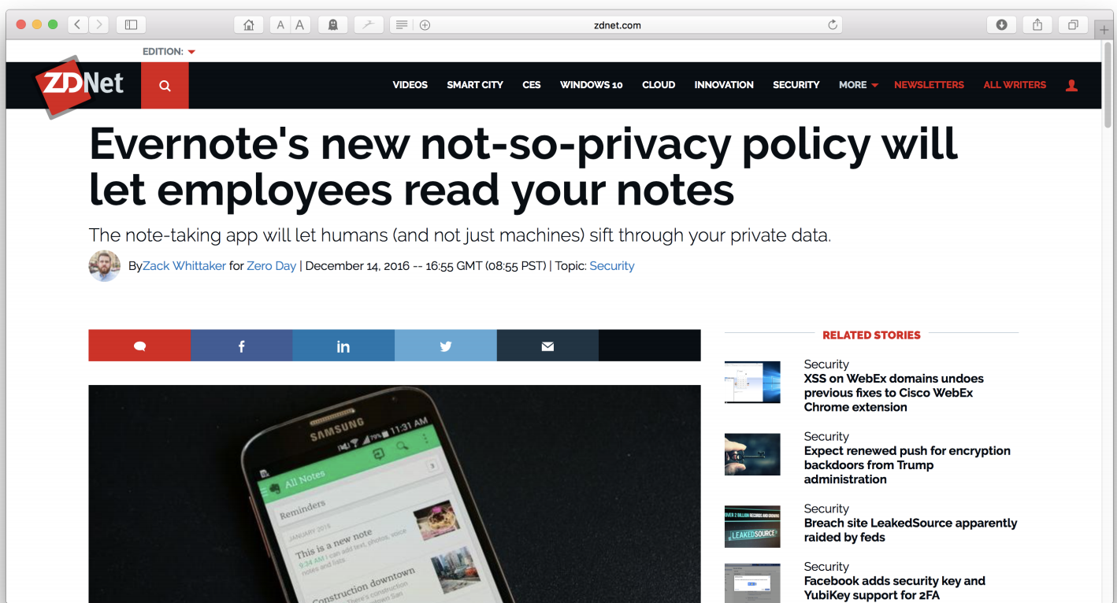
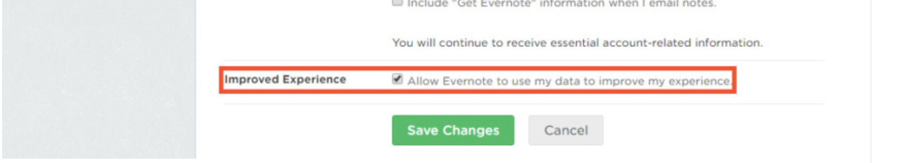
Policy are often not user-centric

Slide 9
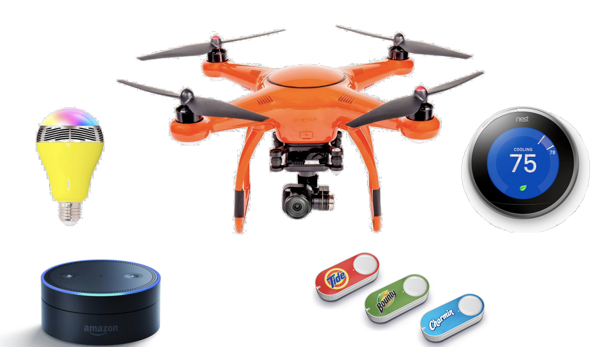
It’s getting worse

Slide 10
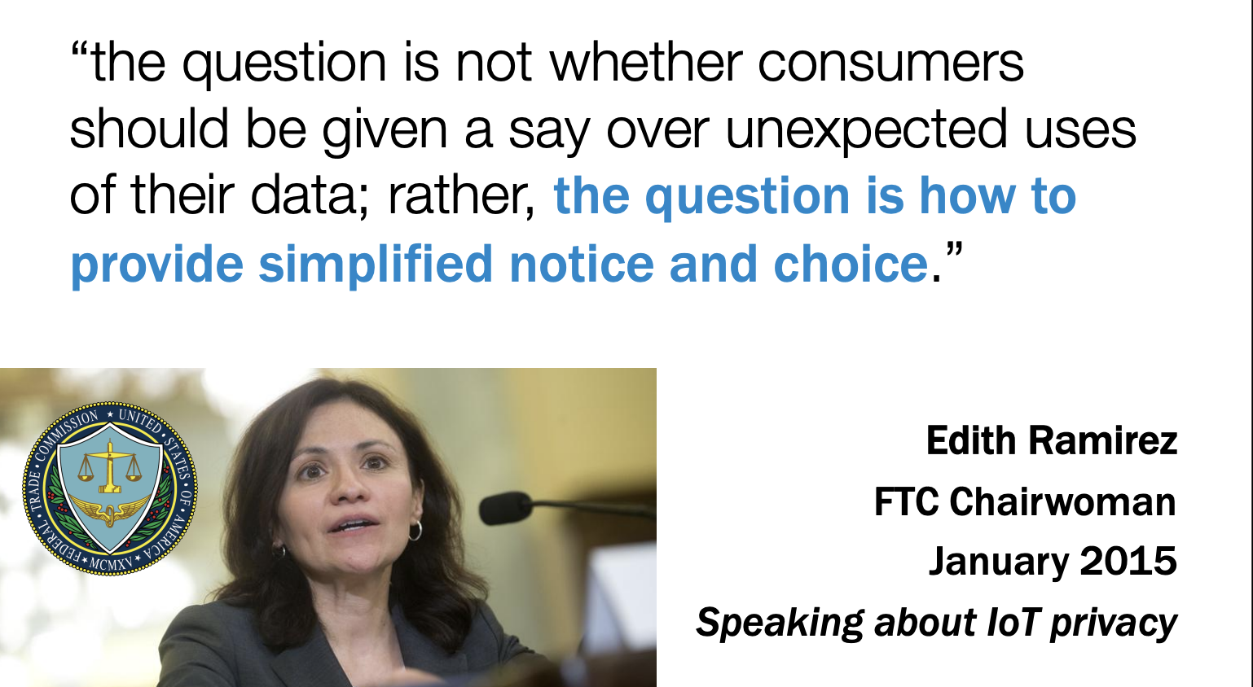
Simplified notice and choice

Slide 11
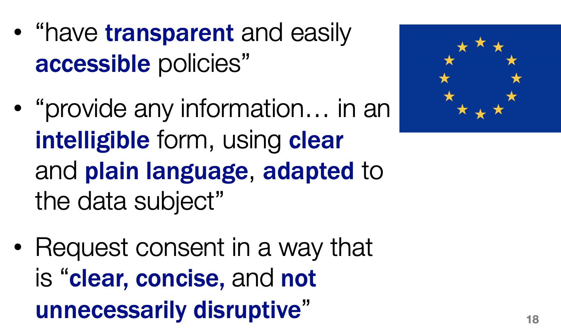
GDPR requirement

Slide 12
Different notice format
Research needed to develop:
– concise and easily understandable formats for showing policies
– easy to extract information from human-readable policy

Slide 13
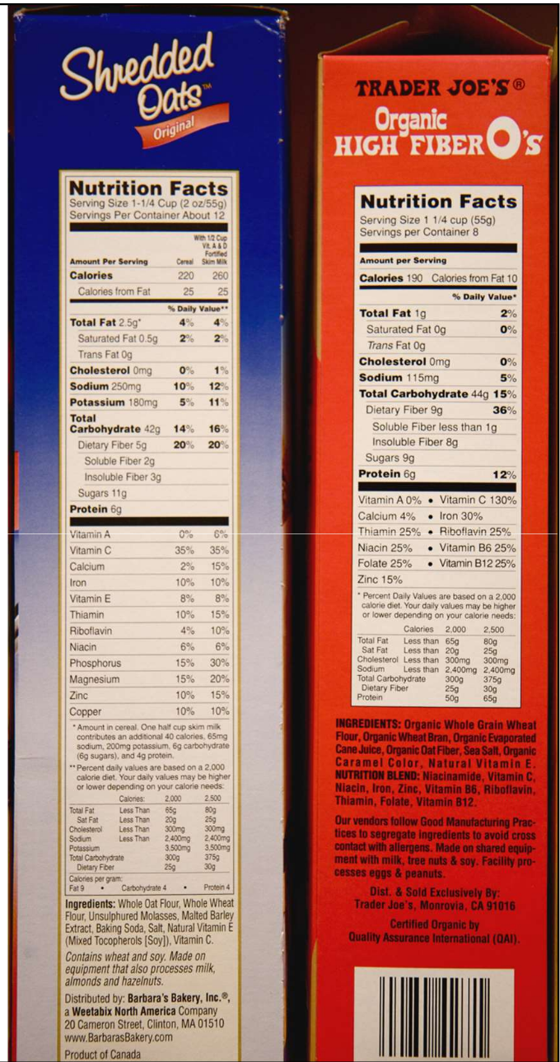
Towards a privacy “nutrition label”
Standardized format
– People learn where to find answers
– Facilitates policy comparisons
Standardized language
– People learn terminology
Brief
– People find info quickly
Linked to extended view
– Get more details if needed

Slide 14
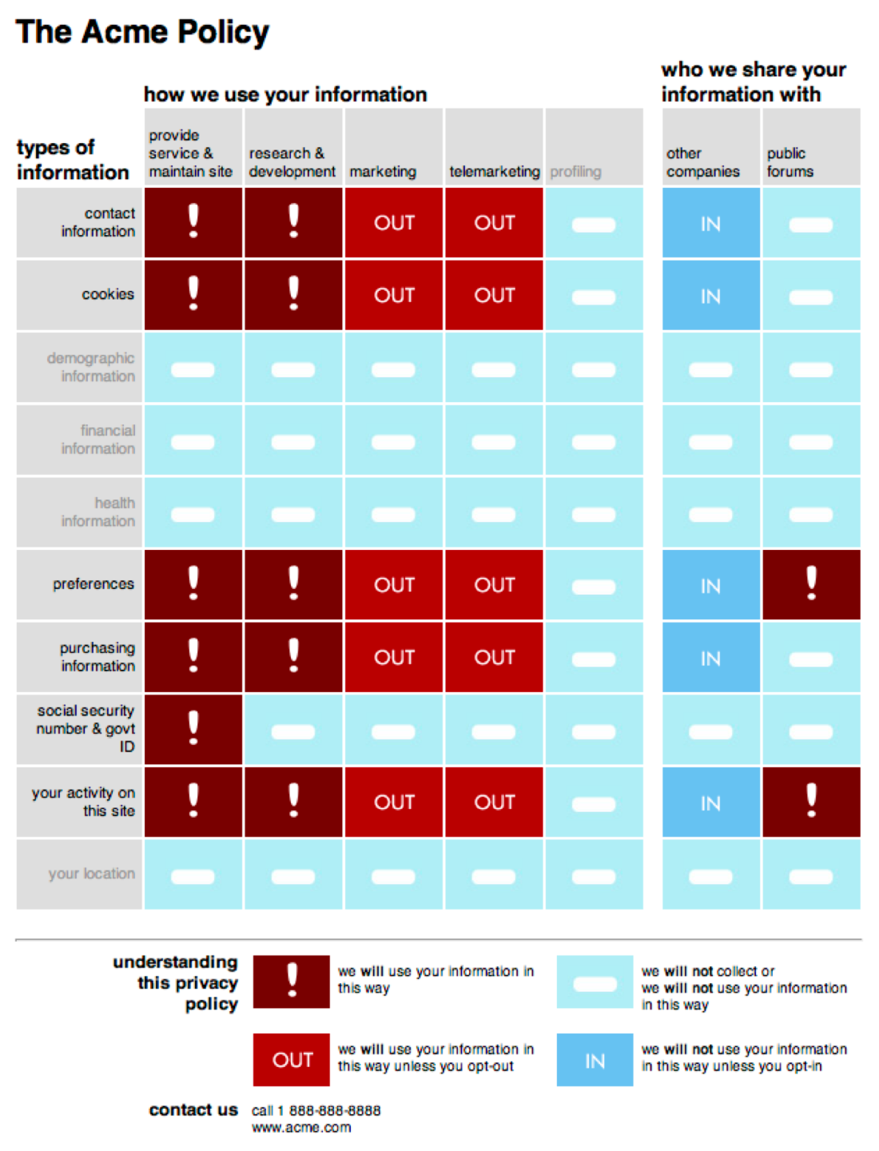
Privacy nutrition label
Easy lookup to determine:
– What data?
– For What purpose?
– With Whom to share?
Emulate nutrition labels
– easy to compare
– short notice
P.G. Kelley, J. Bresee, L.F. Cranor, and R.W. Reeder. A “Nutrition Label” for Privacy. SOUPS 2009.
P.G. Kelley, L.J. Cesca, J. Bresee, and L.F. Cranor. Standardizing Privacy Notices: An Online Study of the Nutrition Label Approach. CHI2010.

Slide 15
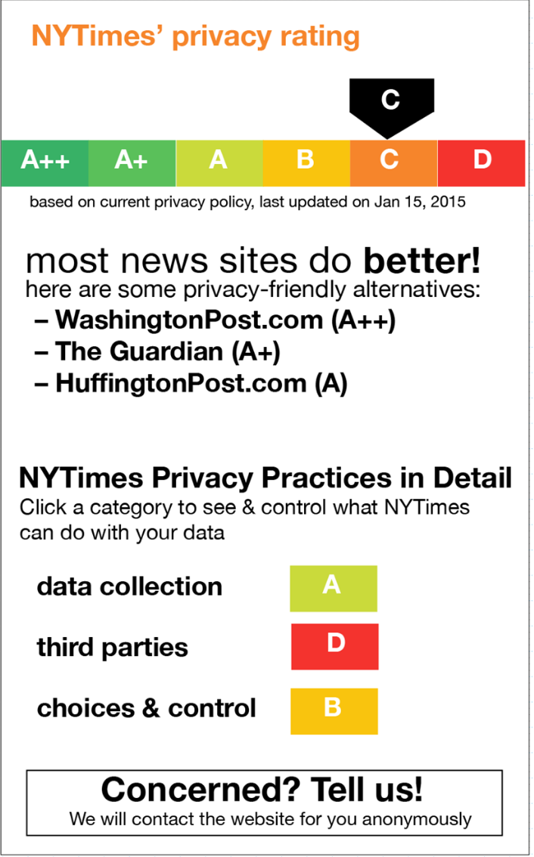
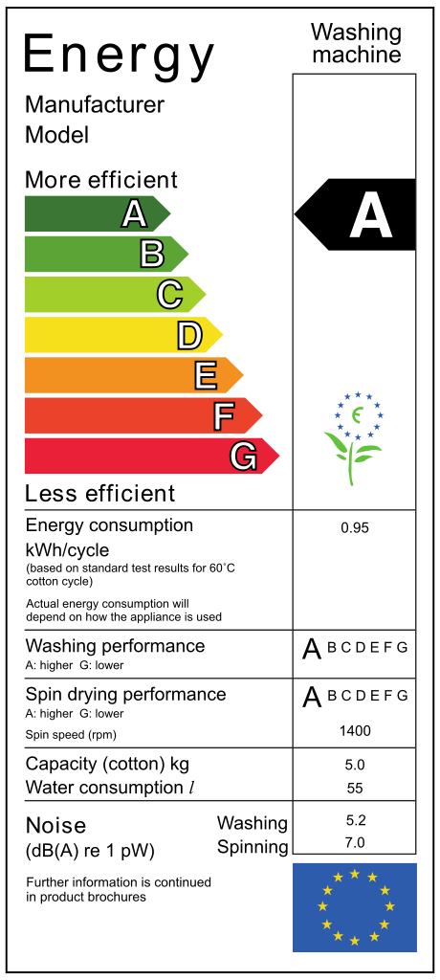
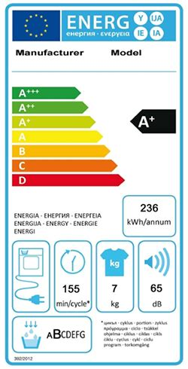
Rating labels
rate website on scale
give specific alternatives
inspired by energy labels

Slide 16
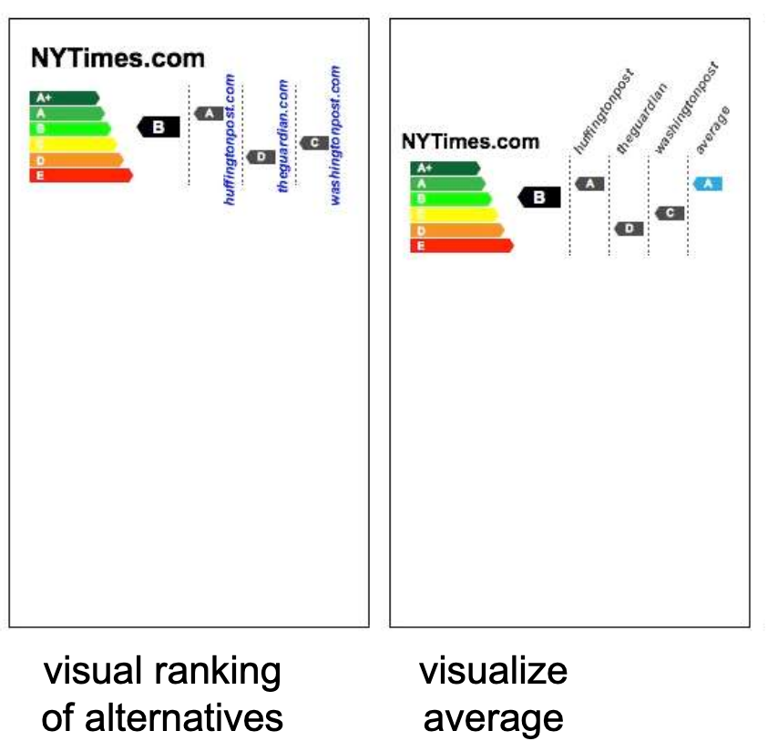
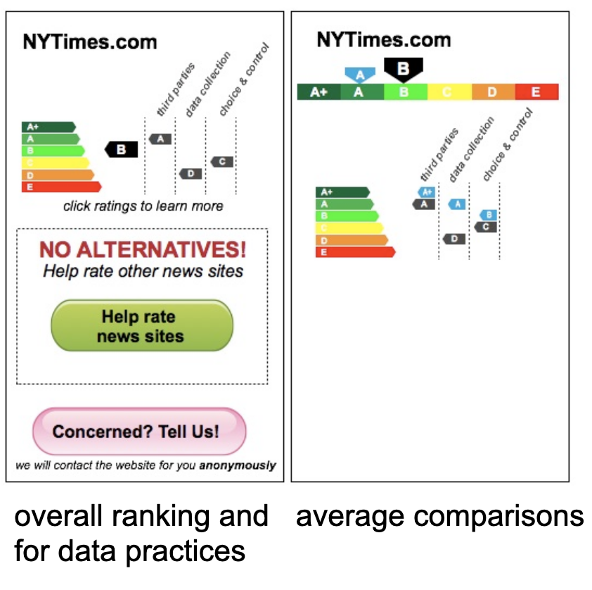
Comparative ranking

Slide 17
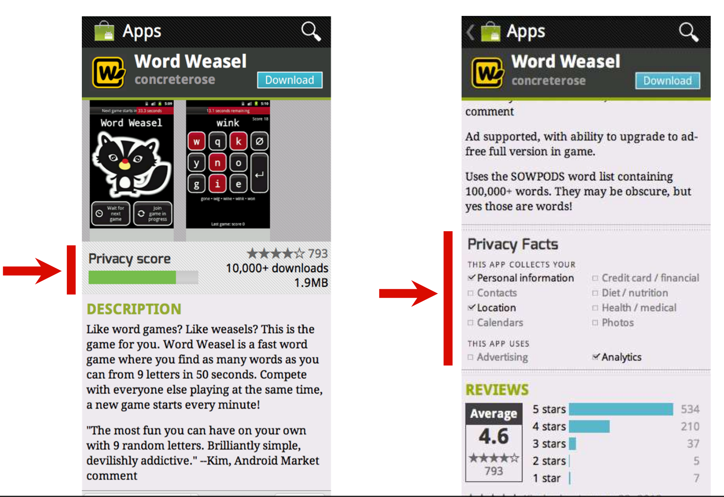
Privacy label for Android

Slide 18
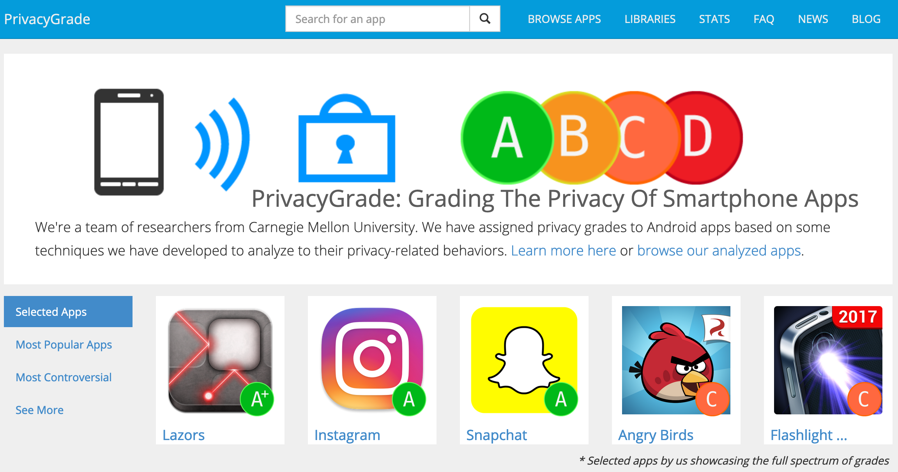
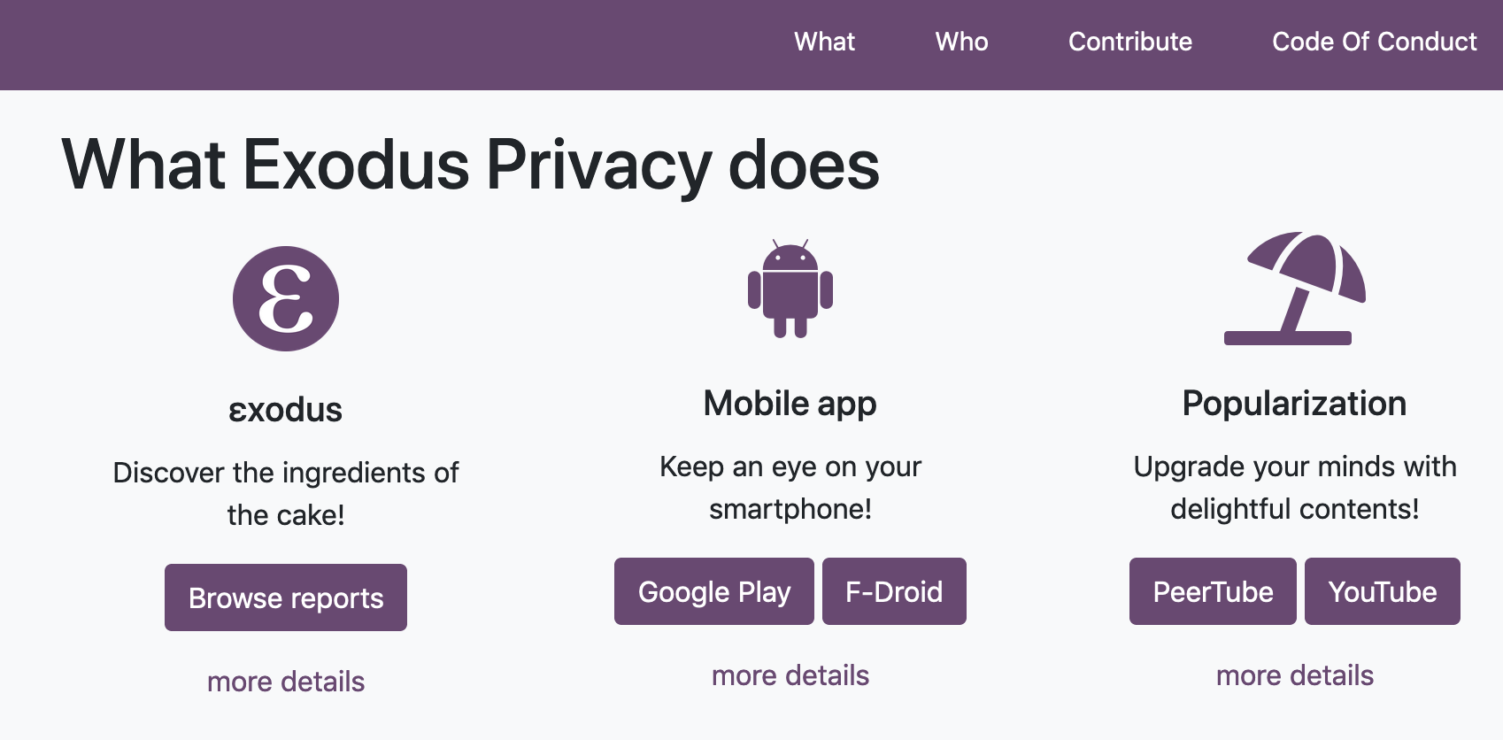
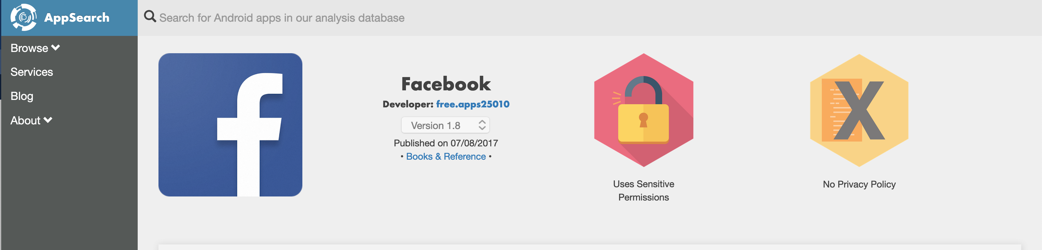
Online tools to analyse apps
http://privacygrade.org/
https://exodus-privacy.eu.org
https://search.appcensus.io

Slide 19
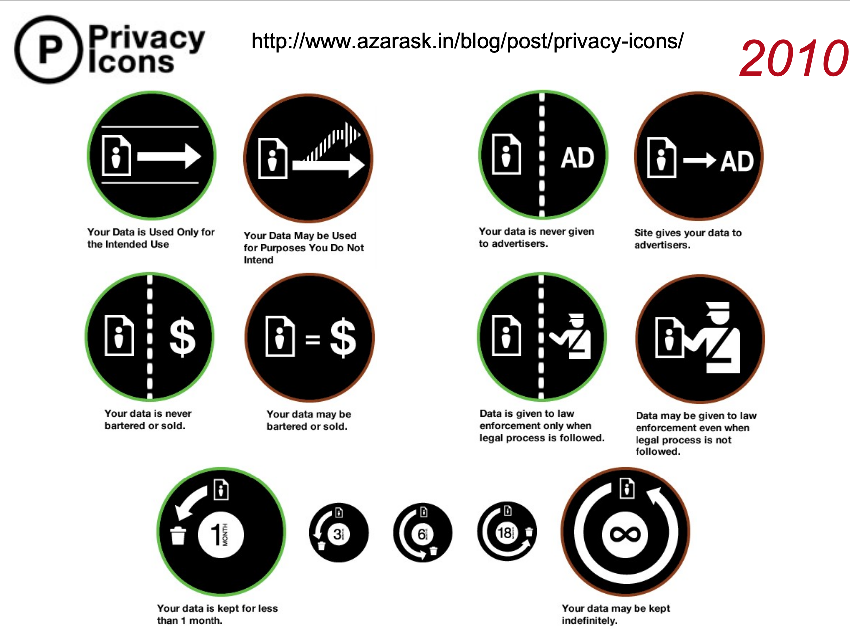
Privacy Icons
Mozilla started it back in 2010
Don’t see much adoption

Slide 20
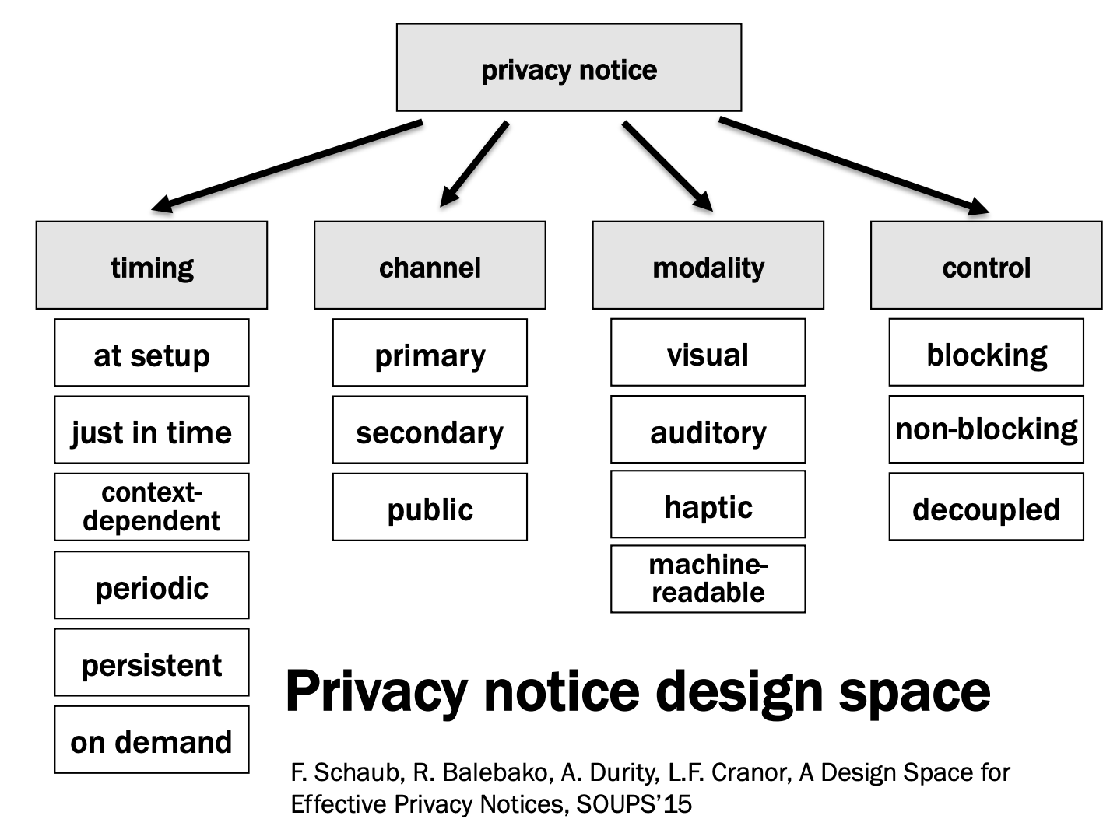
Privacy notice design space

Slide 21
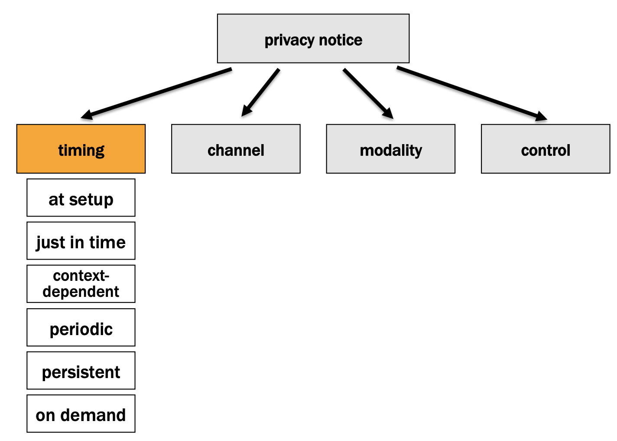

Slide 22
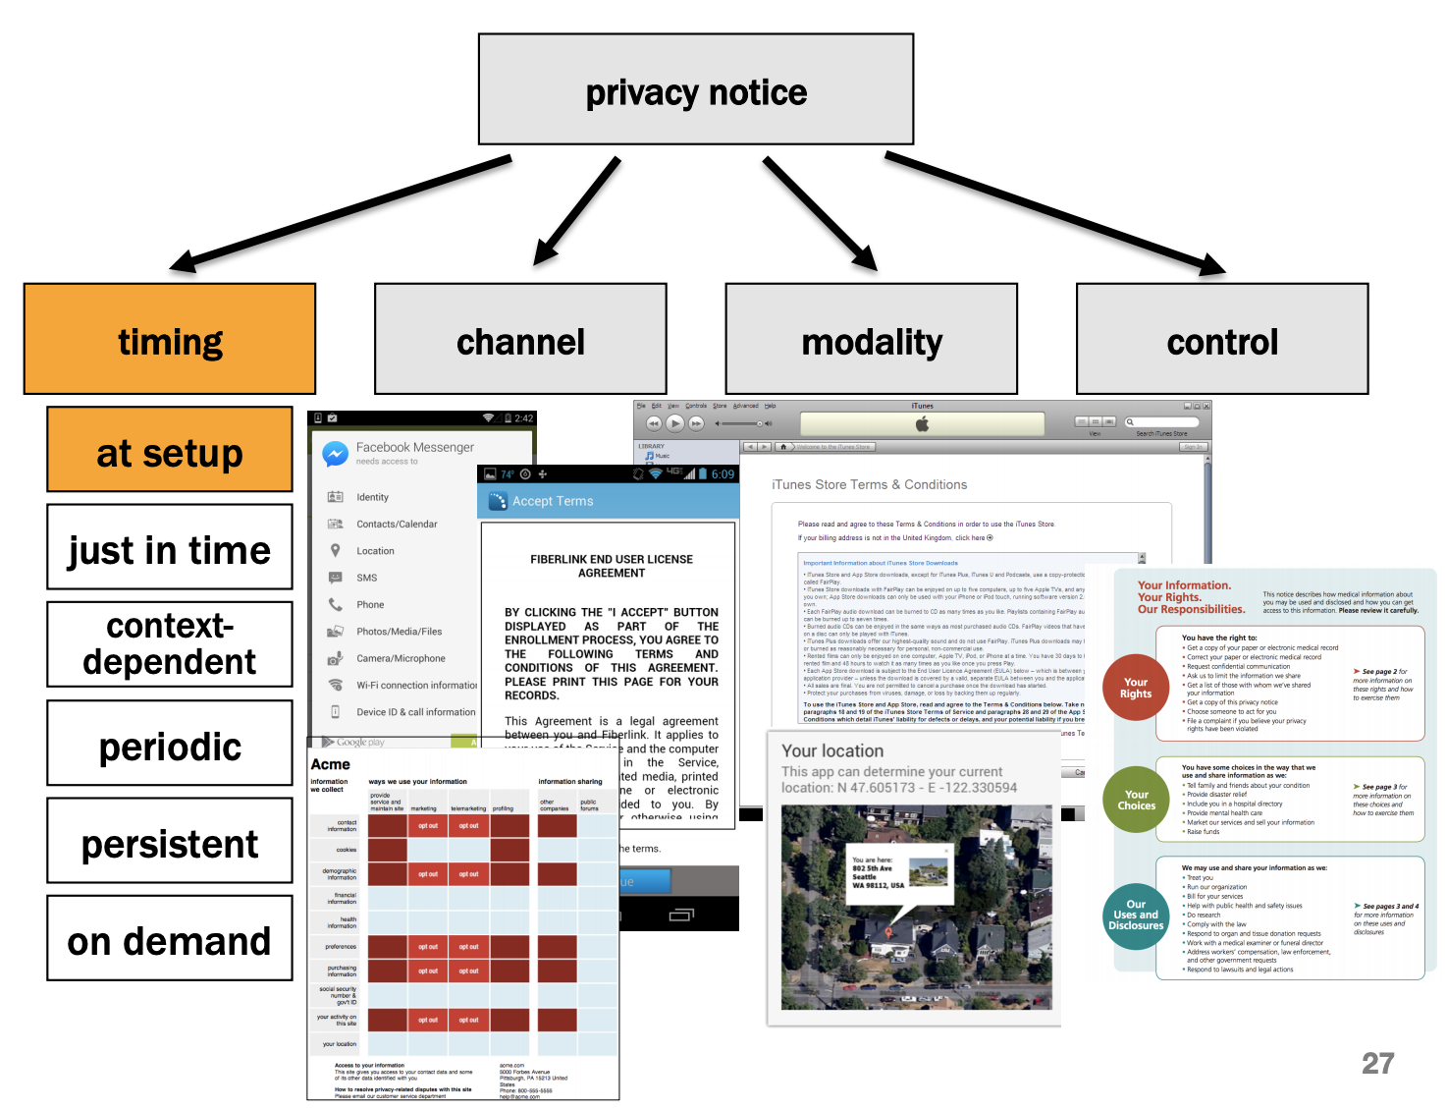

Slide 23
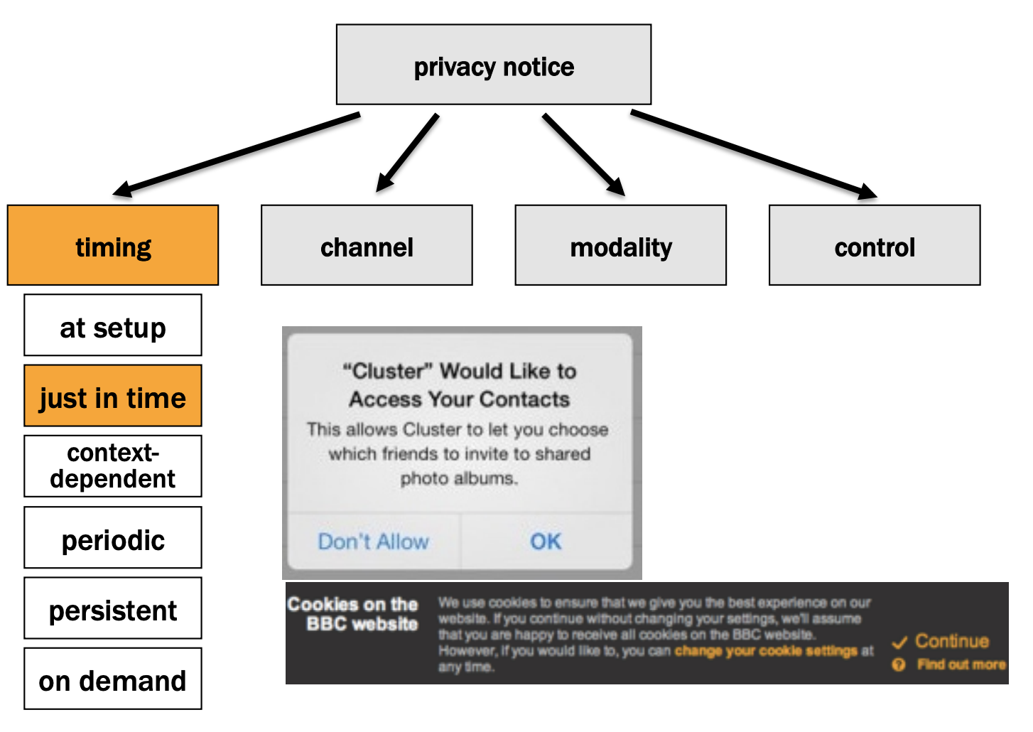

Slide 24
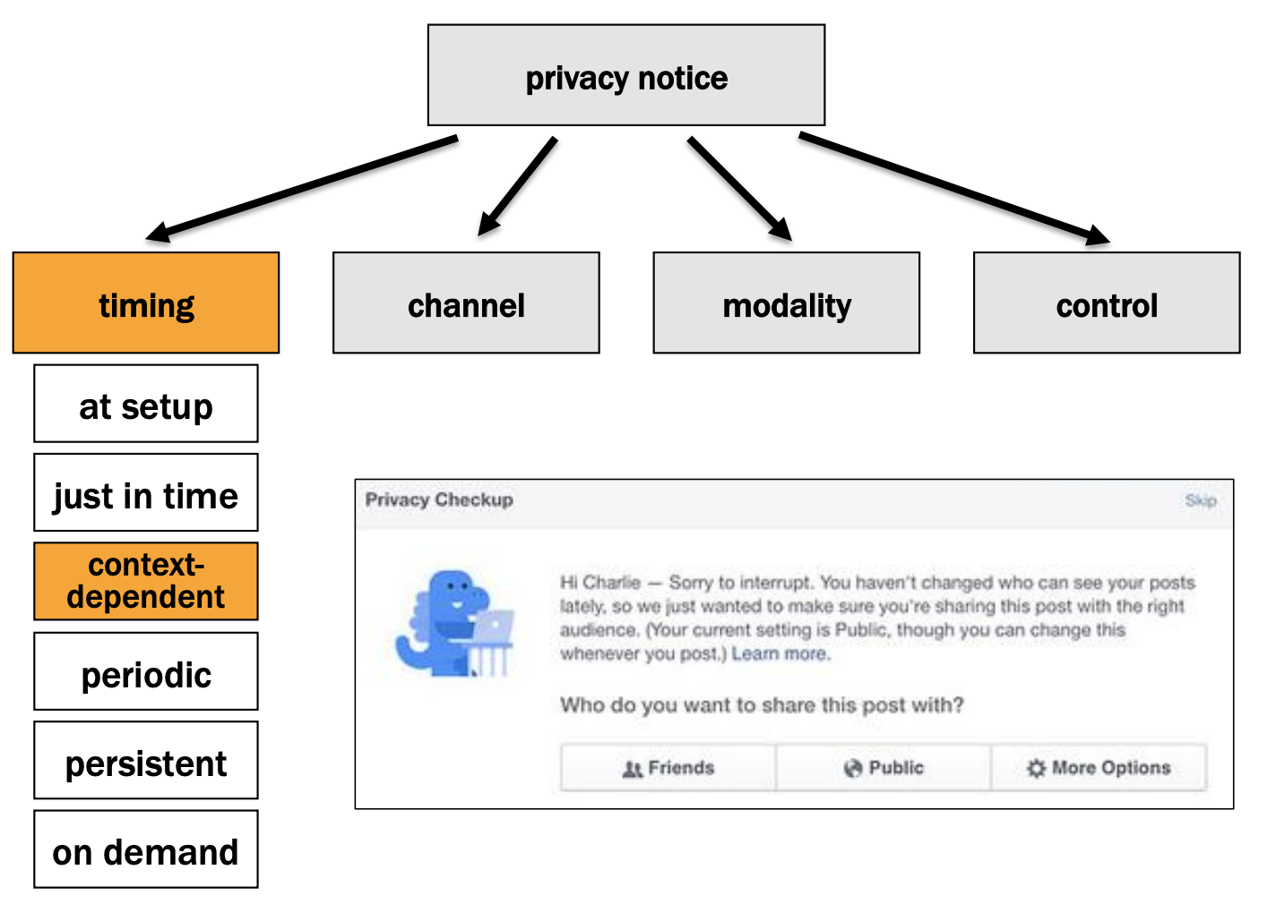

Slide 25
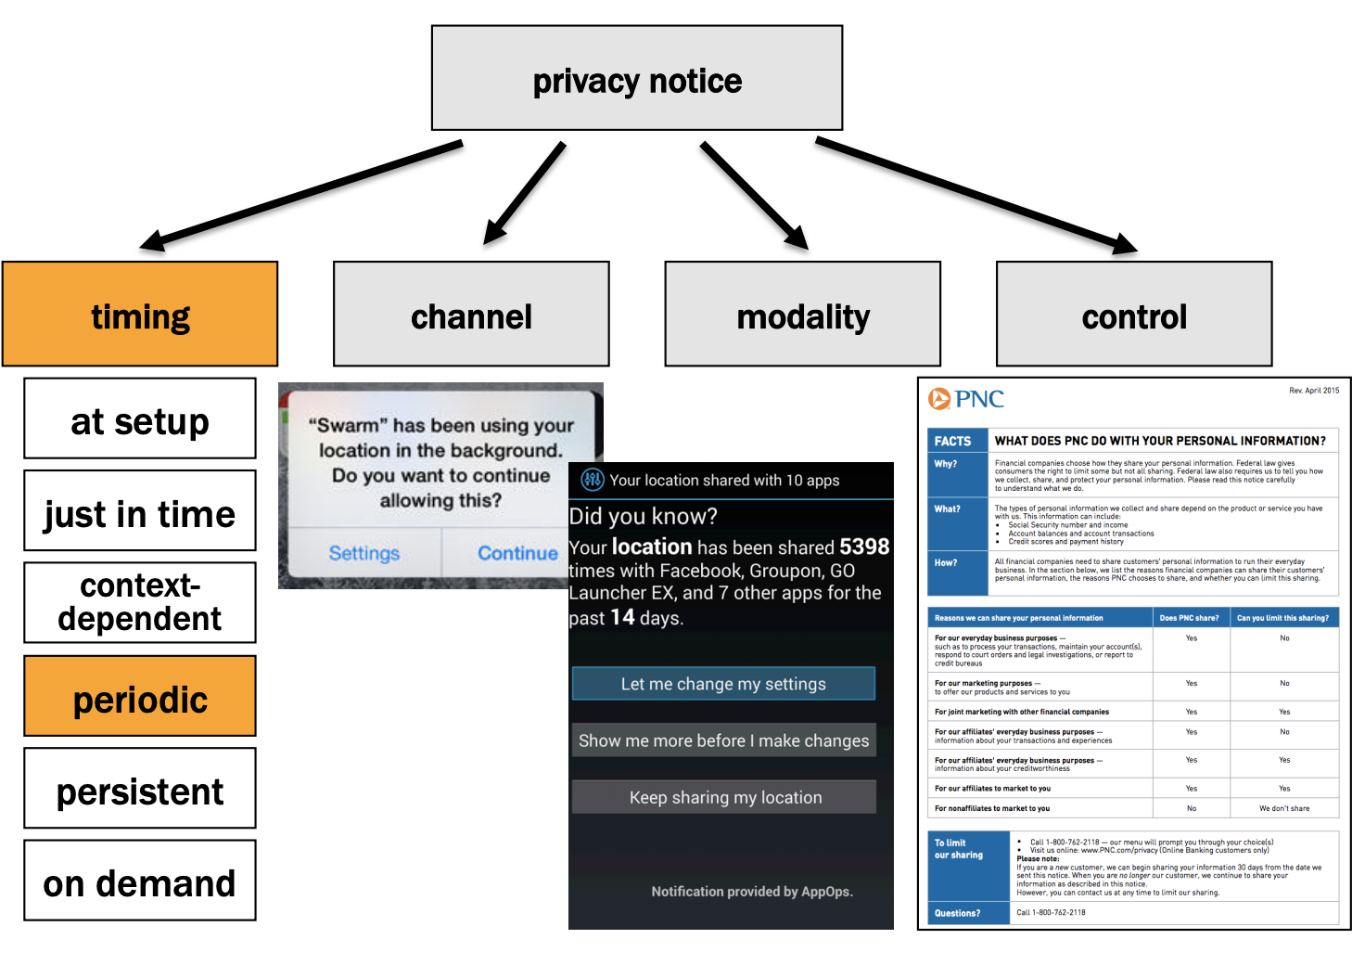

Slide 26
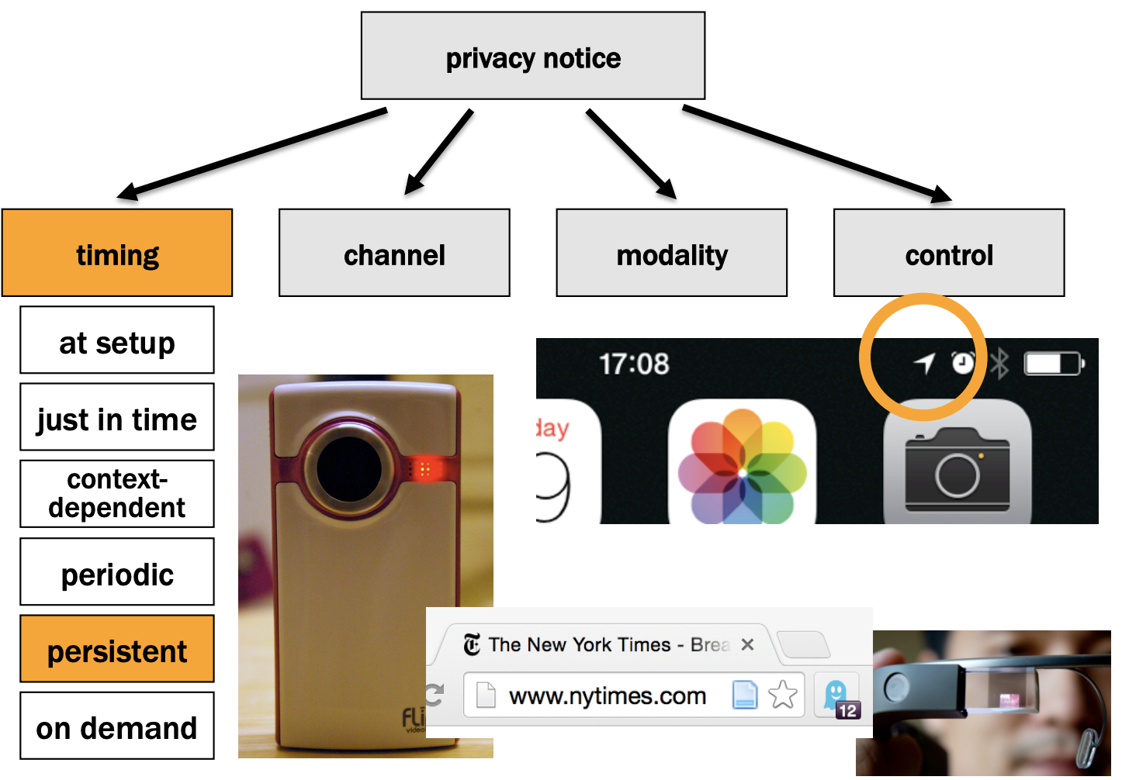

Slide 27
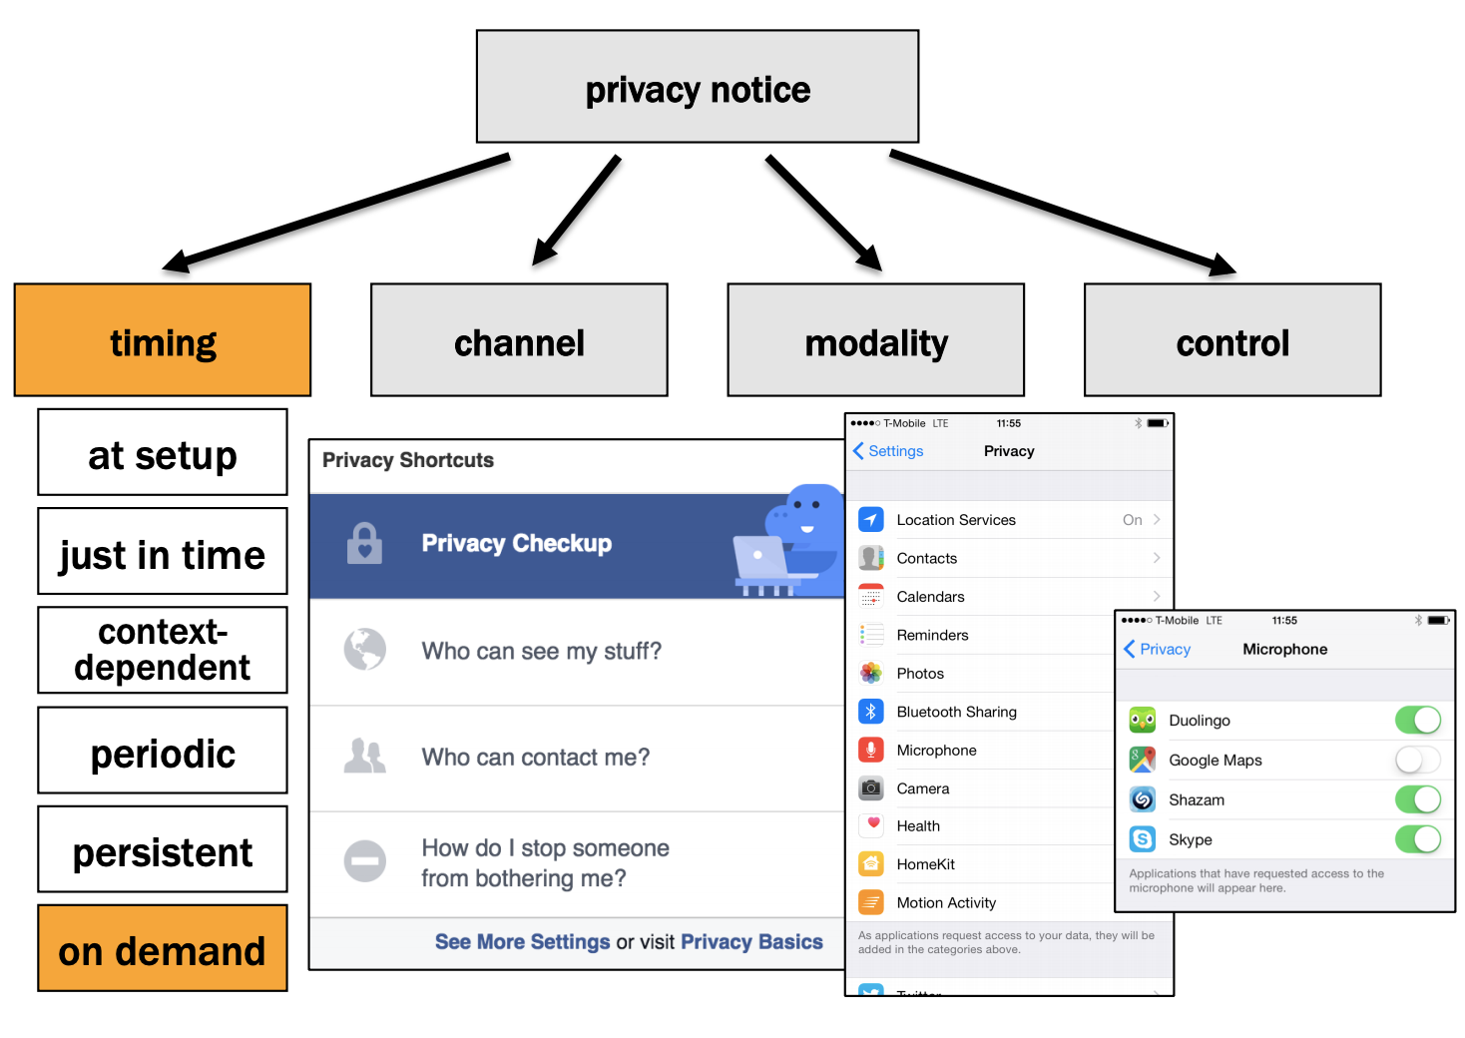

Slide 28
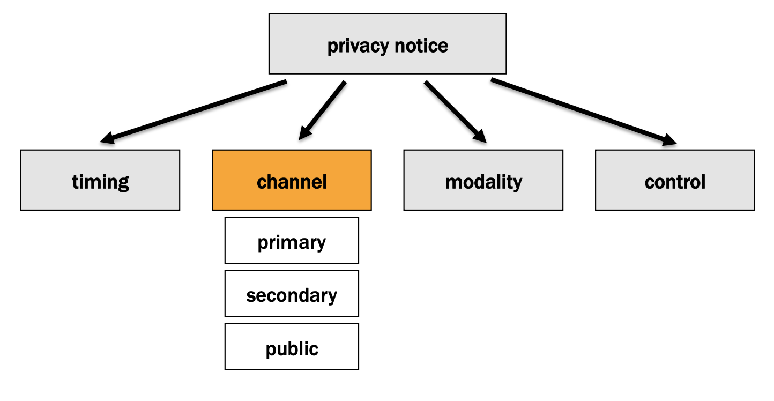

Slide 29
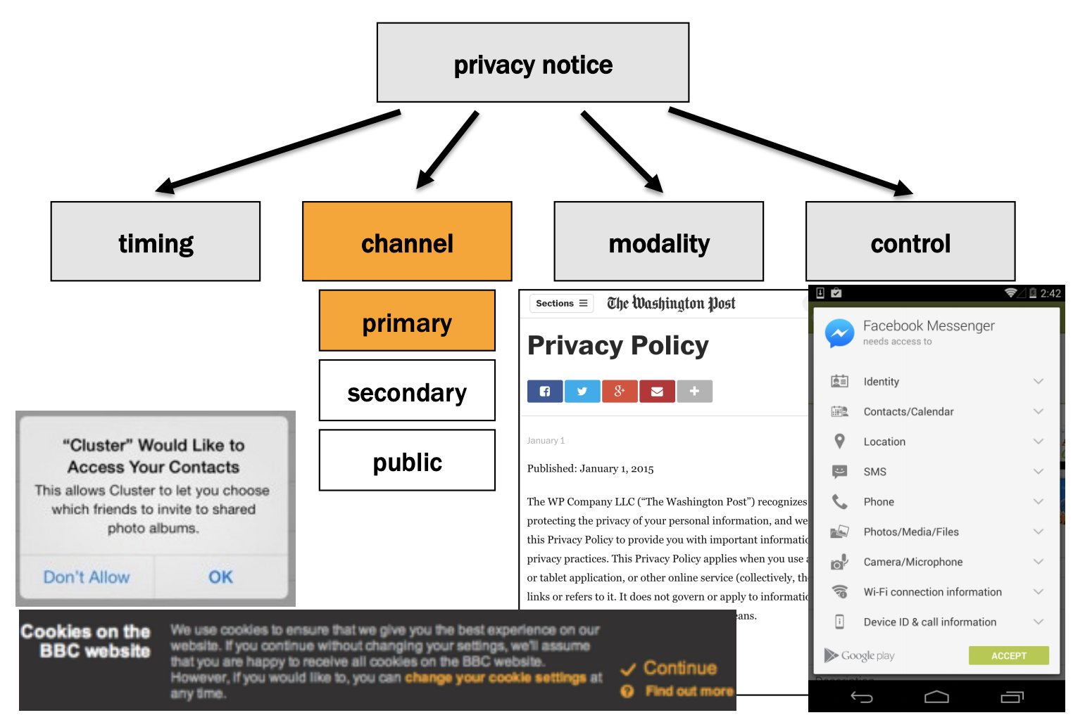

Slide 30
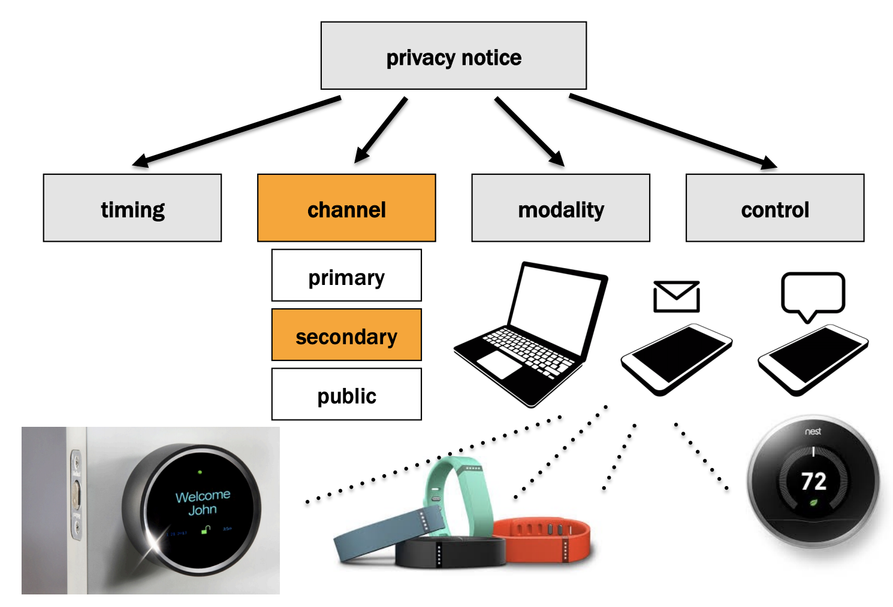

Slide 31
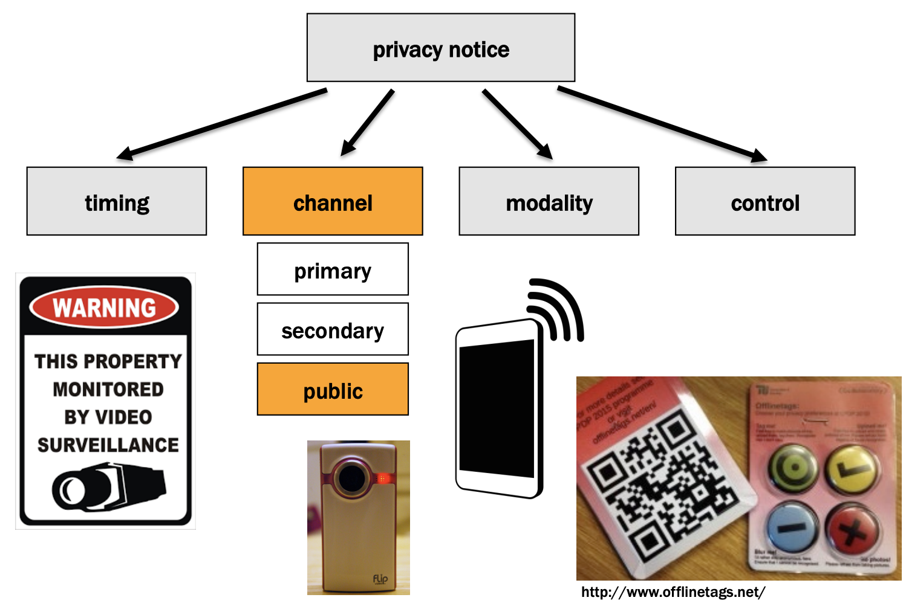

Slide 32
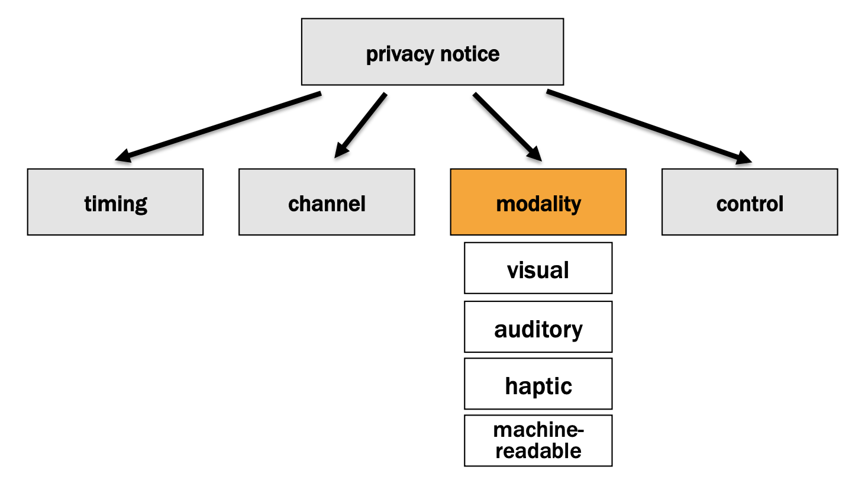

Slide 33
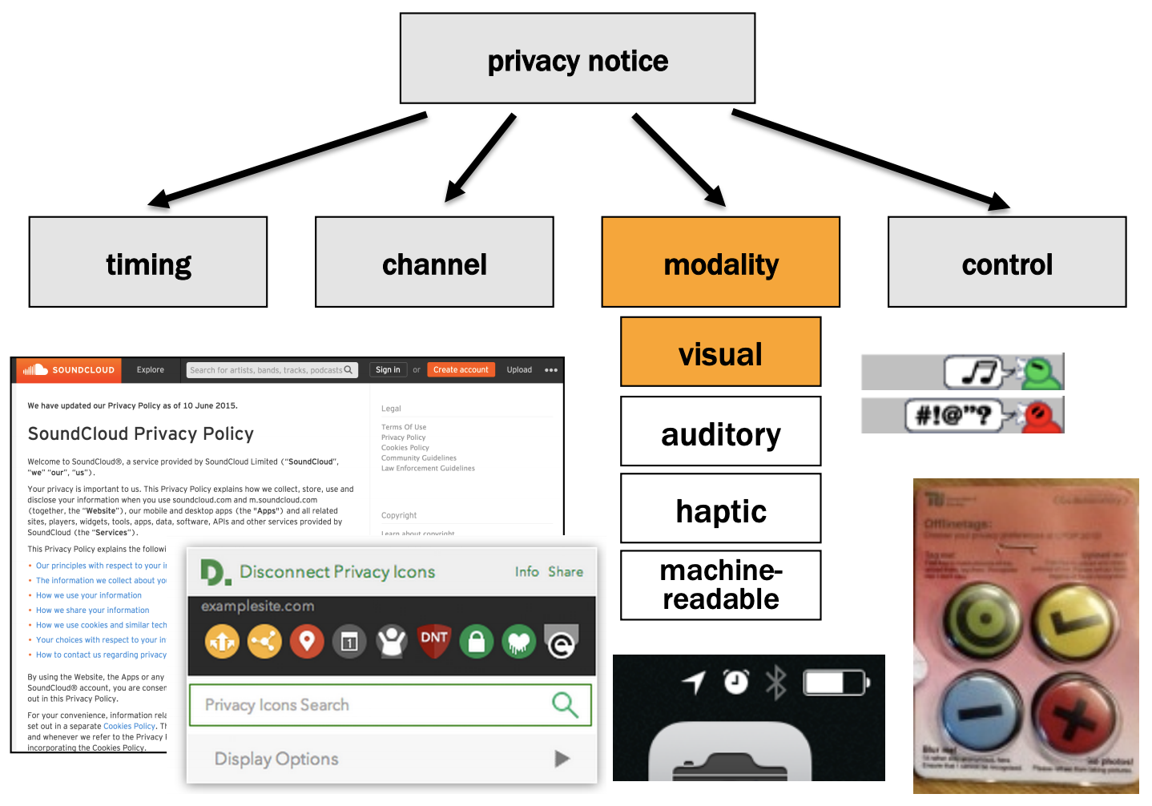

Slide 34
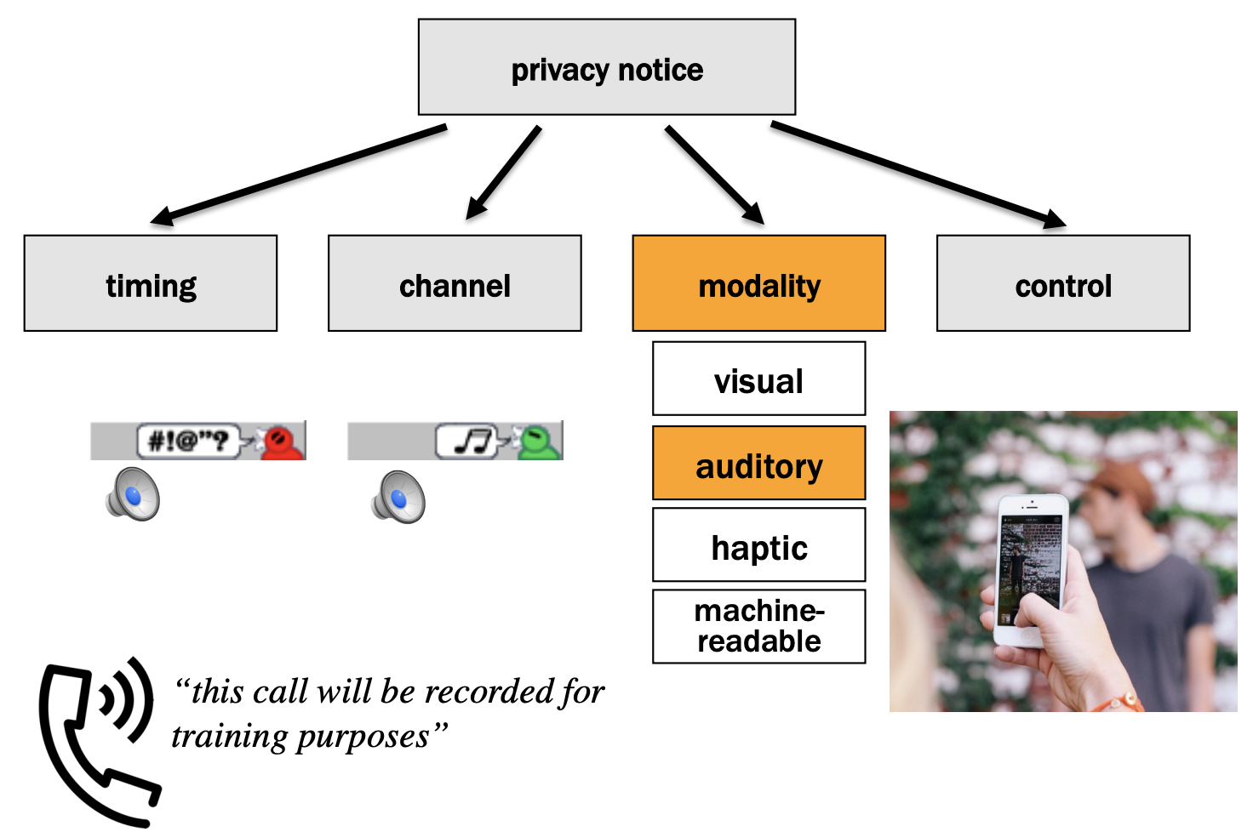

Slide 35
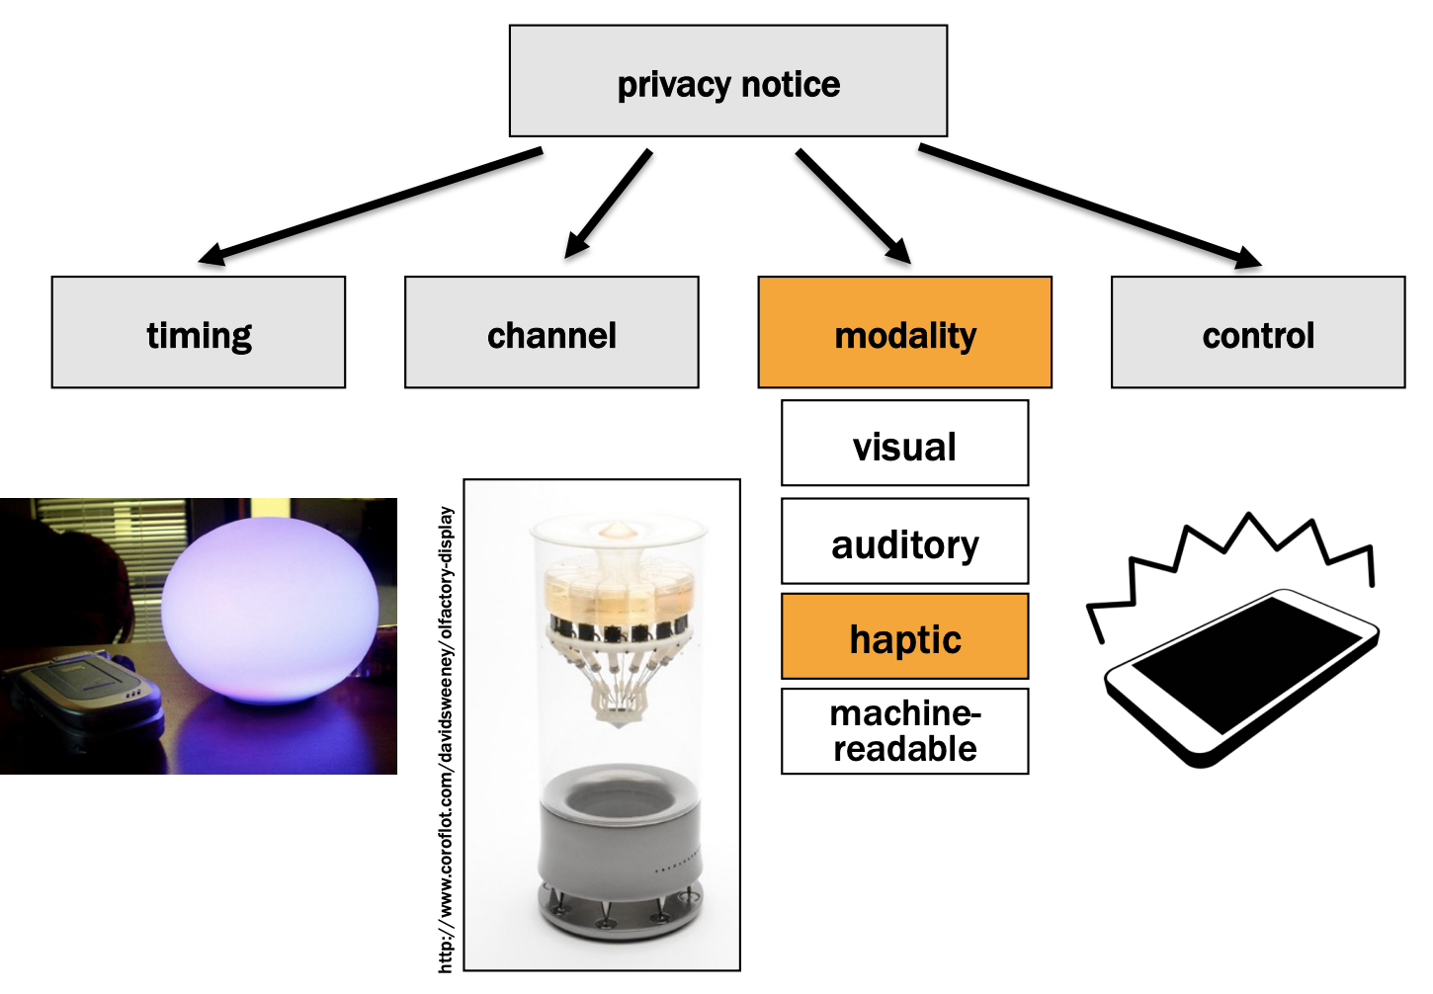

Slide 36
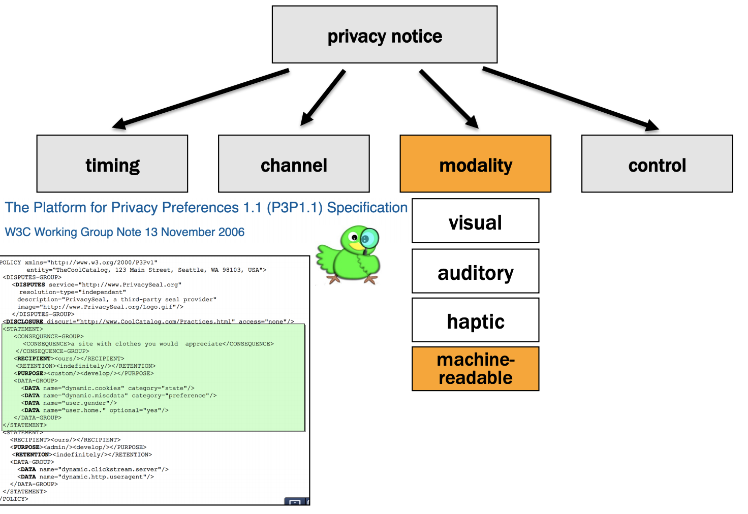

Slide 37
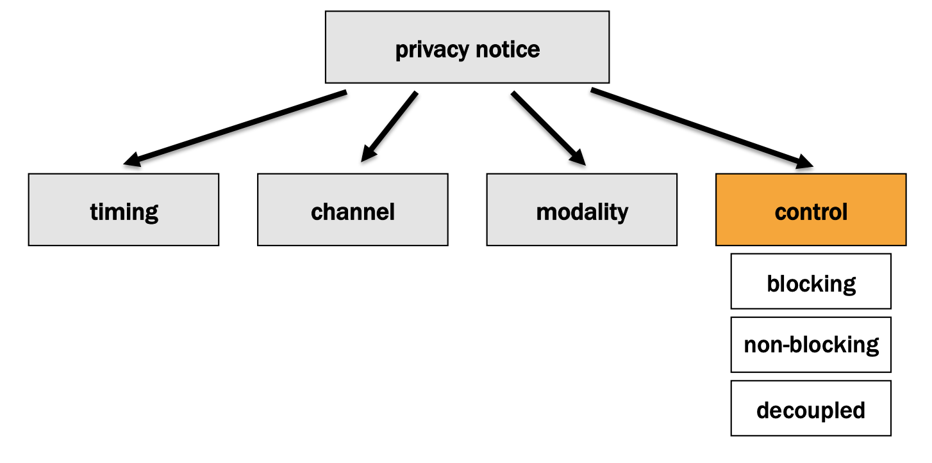

Slide 38
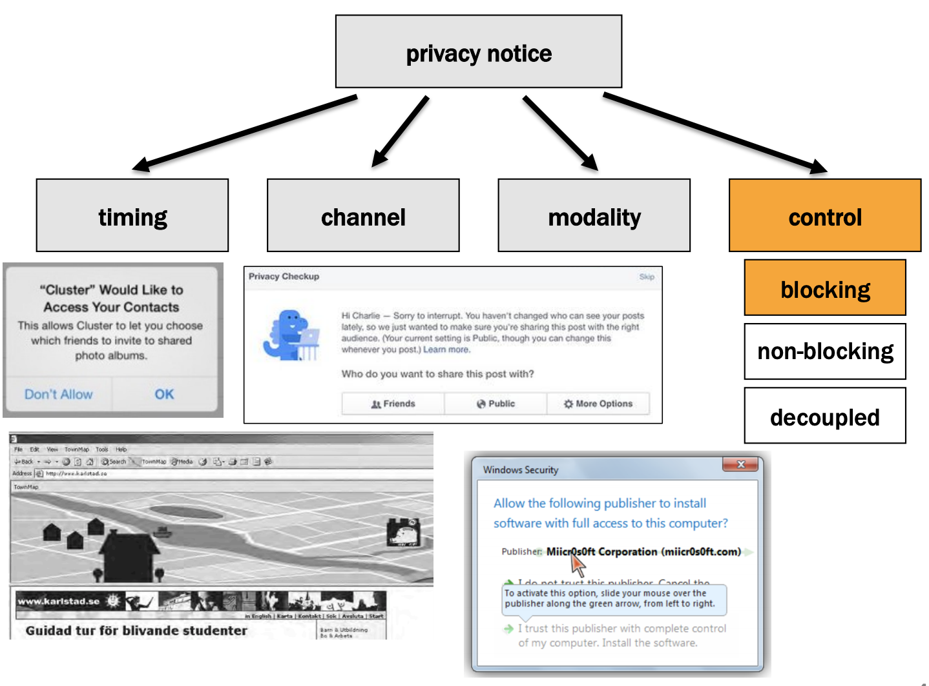

Slide 39
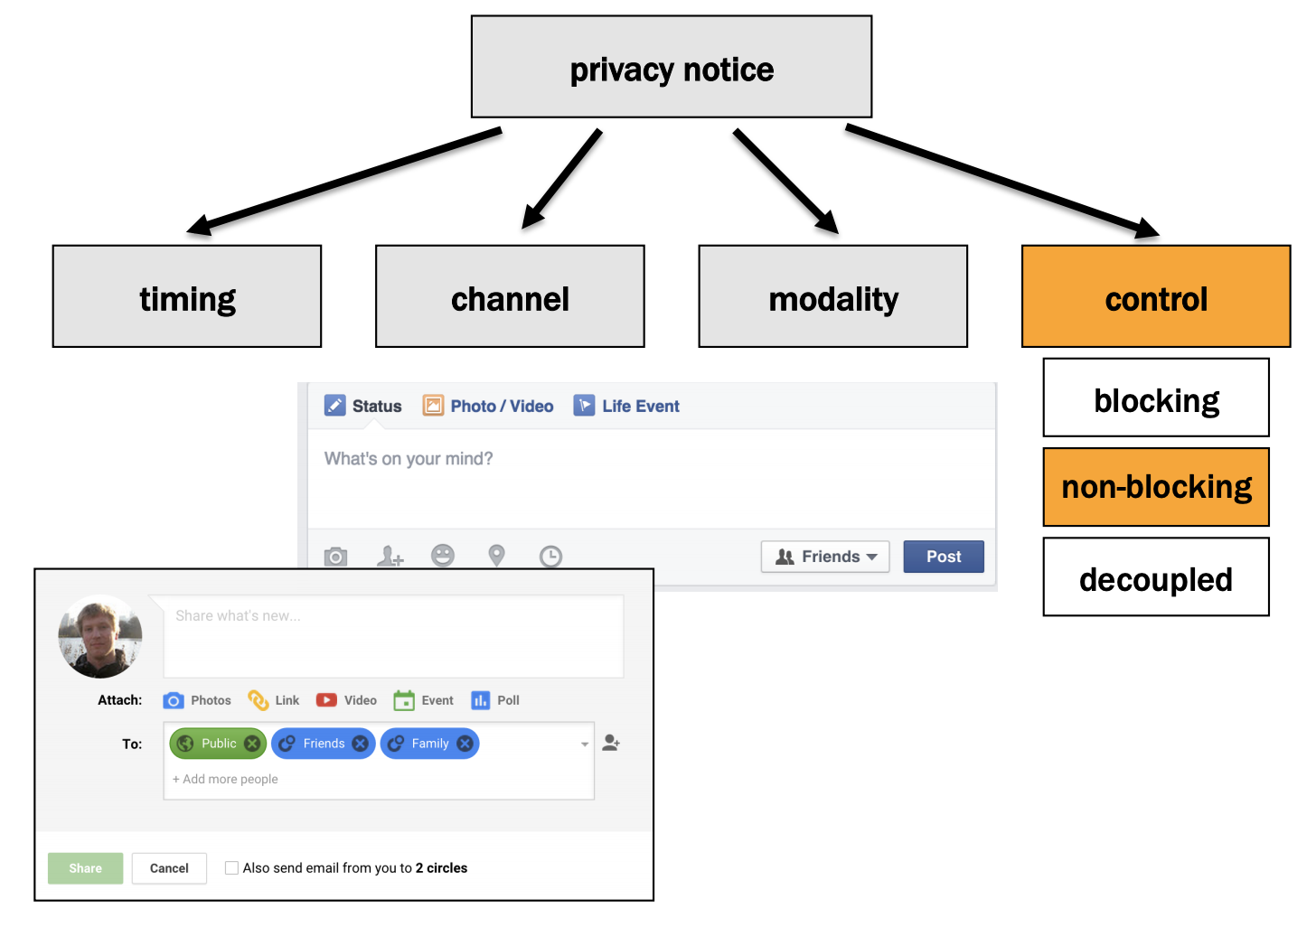

Slide 40
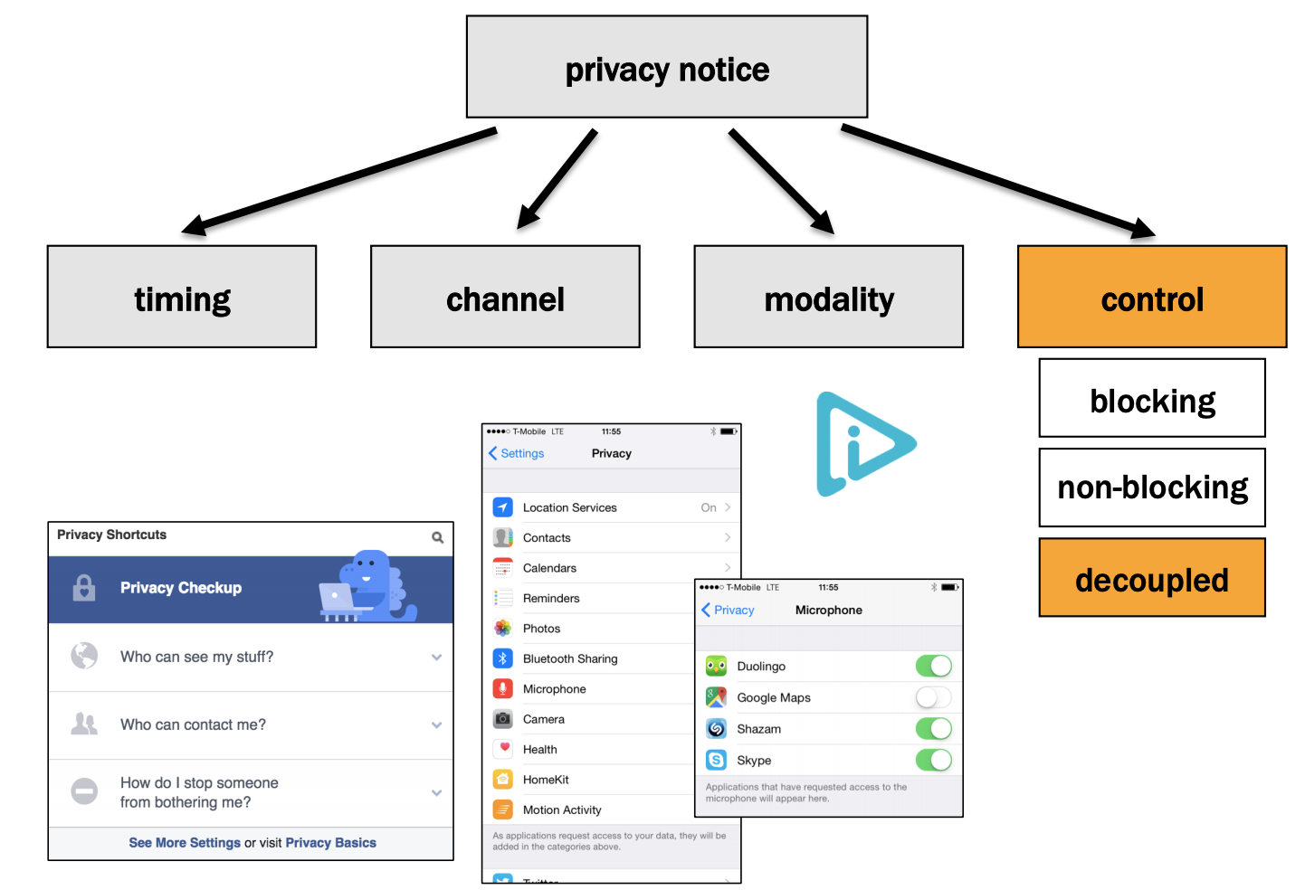

Slide 41
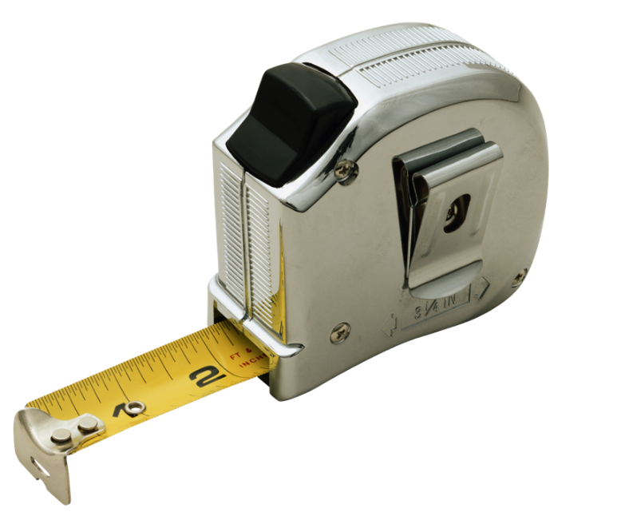
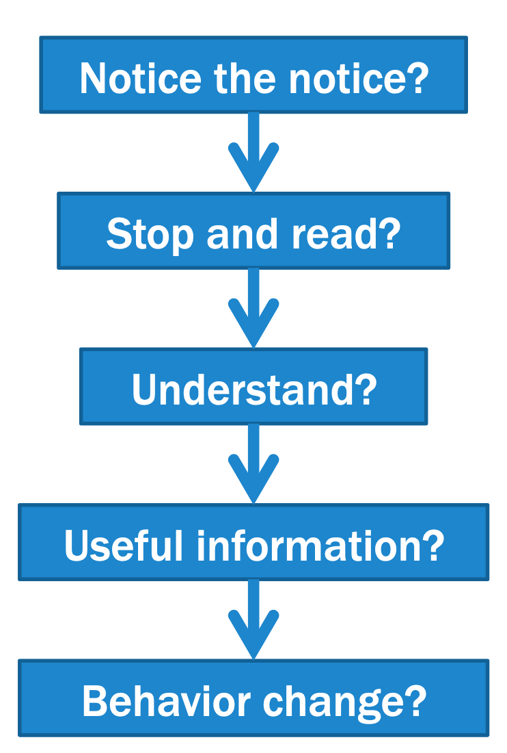
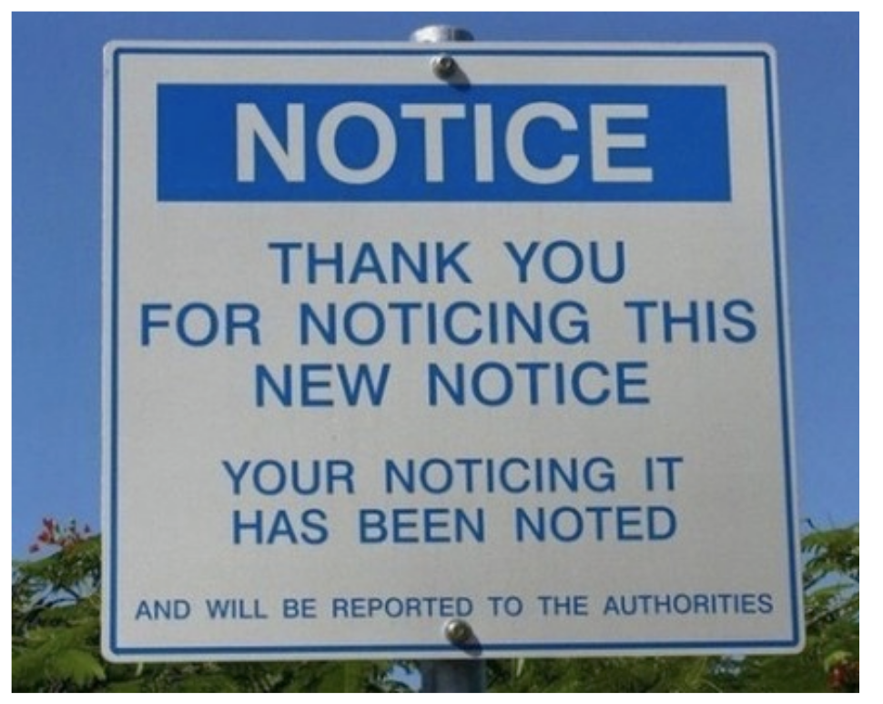
How do we measure effectiveness?
By what criteria should we measure effectiveness?

Slide 42
How can we conduct studies to measure notice effectiveness?
Compare notice versions and no notice
Ask comprehension and/or policy comparison questions
Place notice in context of decision-making task
Use deception so participants don’t realize study is about notices

Slide 43
What should we measure?
How much time do they spend with notice?
More time could mean they find notice engaging, or hard to understand
Time and accuracy to answer comprehension questions?
Time and accuracy to compare policies?
Do they report that this is information they want to know?
Does information impact decisions or behavior?

Slide 44
Privacy notice evaluation studies
App notice timing
Privacy “Nutrition Labels”
AdChoices icon and taglines
Privacy meters in search results
Attention
Comprehension
Behavioral change

Slide 45
1. App notice timing
Does the timing of an app privacy notice impact the likelihood that people will notice, read, and remember it?

Slide 46
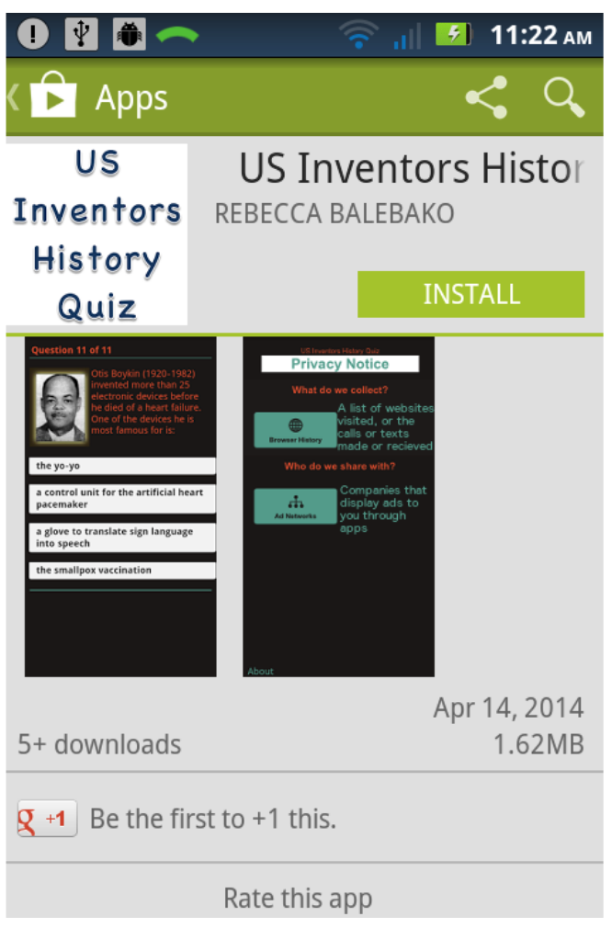
When are app privacy notices most effective?
In the app store?
After users download app?
After users start using app?
R. Balebako, F. Schaub, I. Adjerid, A. Acquisti, L. Cranor. The Impact of Timing on the Salience of Smartphone App Privacy Notices. SPSM 2015.

Slide 47
Web survey and field experiment
277 survey participants
–played virtual app online
–asked to recall privacy notice minutes later
126 field experiment participants
–downloaded and played app
–asked to recall privacy notice the next day

Slide 48
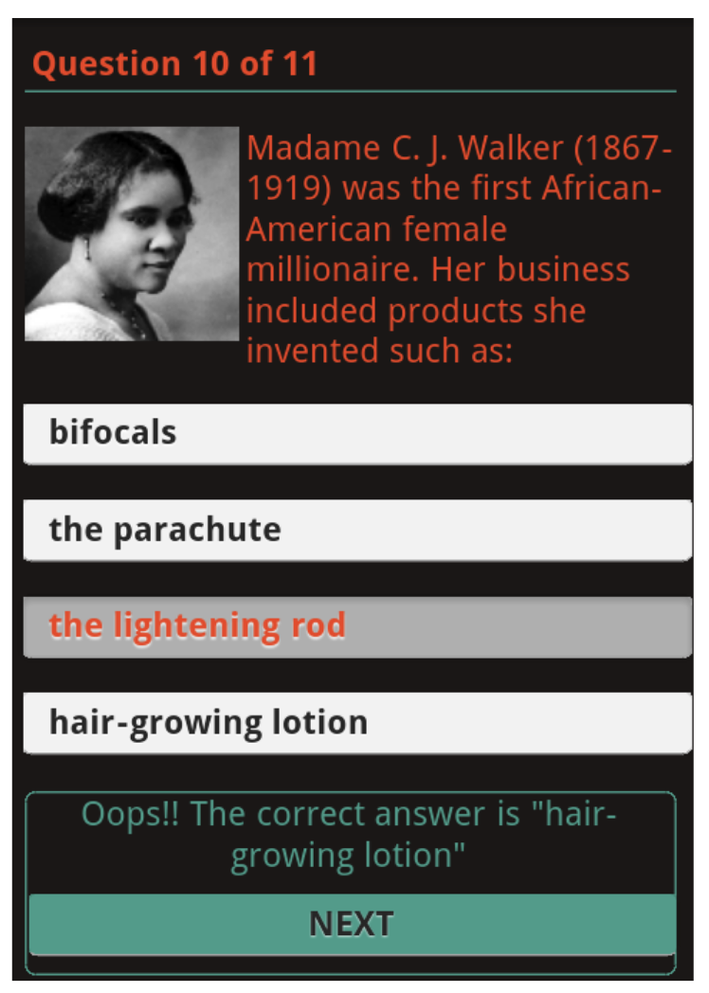
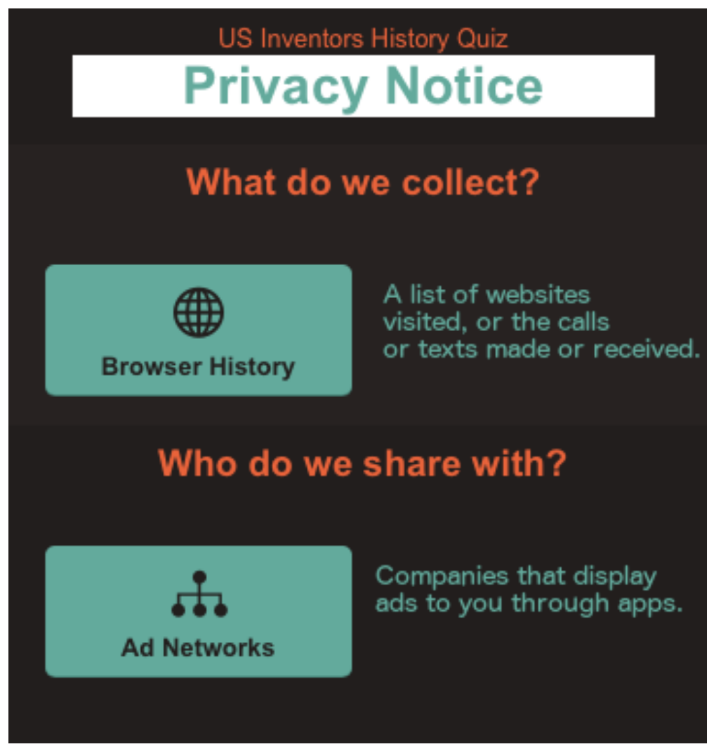
Downloaded app detail
App is a quiz about American inventors
Notice based on NTIA prototype

Slide 49

Participants remembered notices shown during app use
Notice shown in app store was not significantly different than no notice
Notice shown in app use had better recall than shown in app store
Need to place notices where they will be noticed and read
User studies can inform design

Slide 50
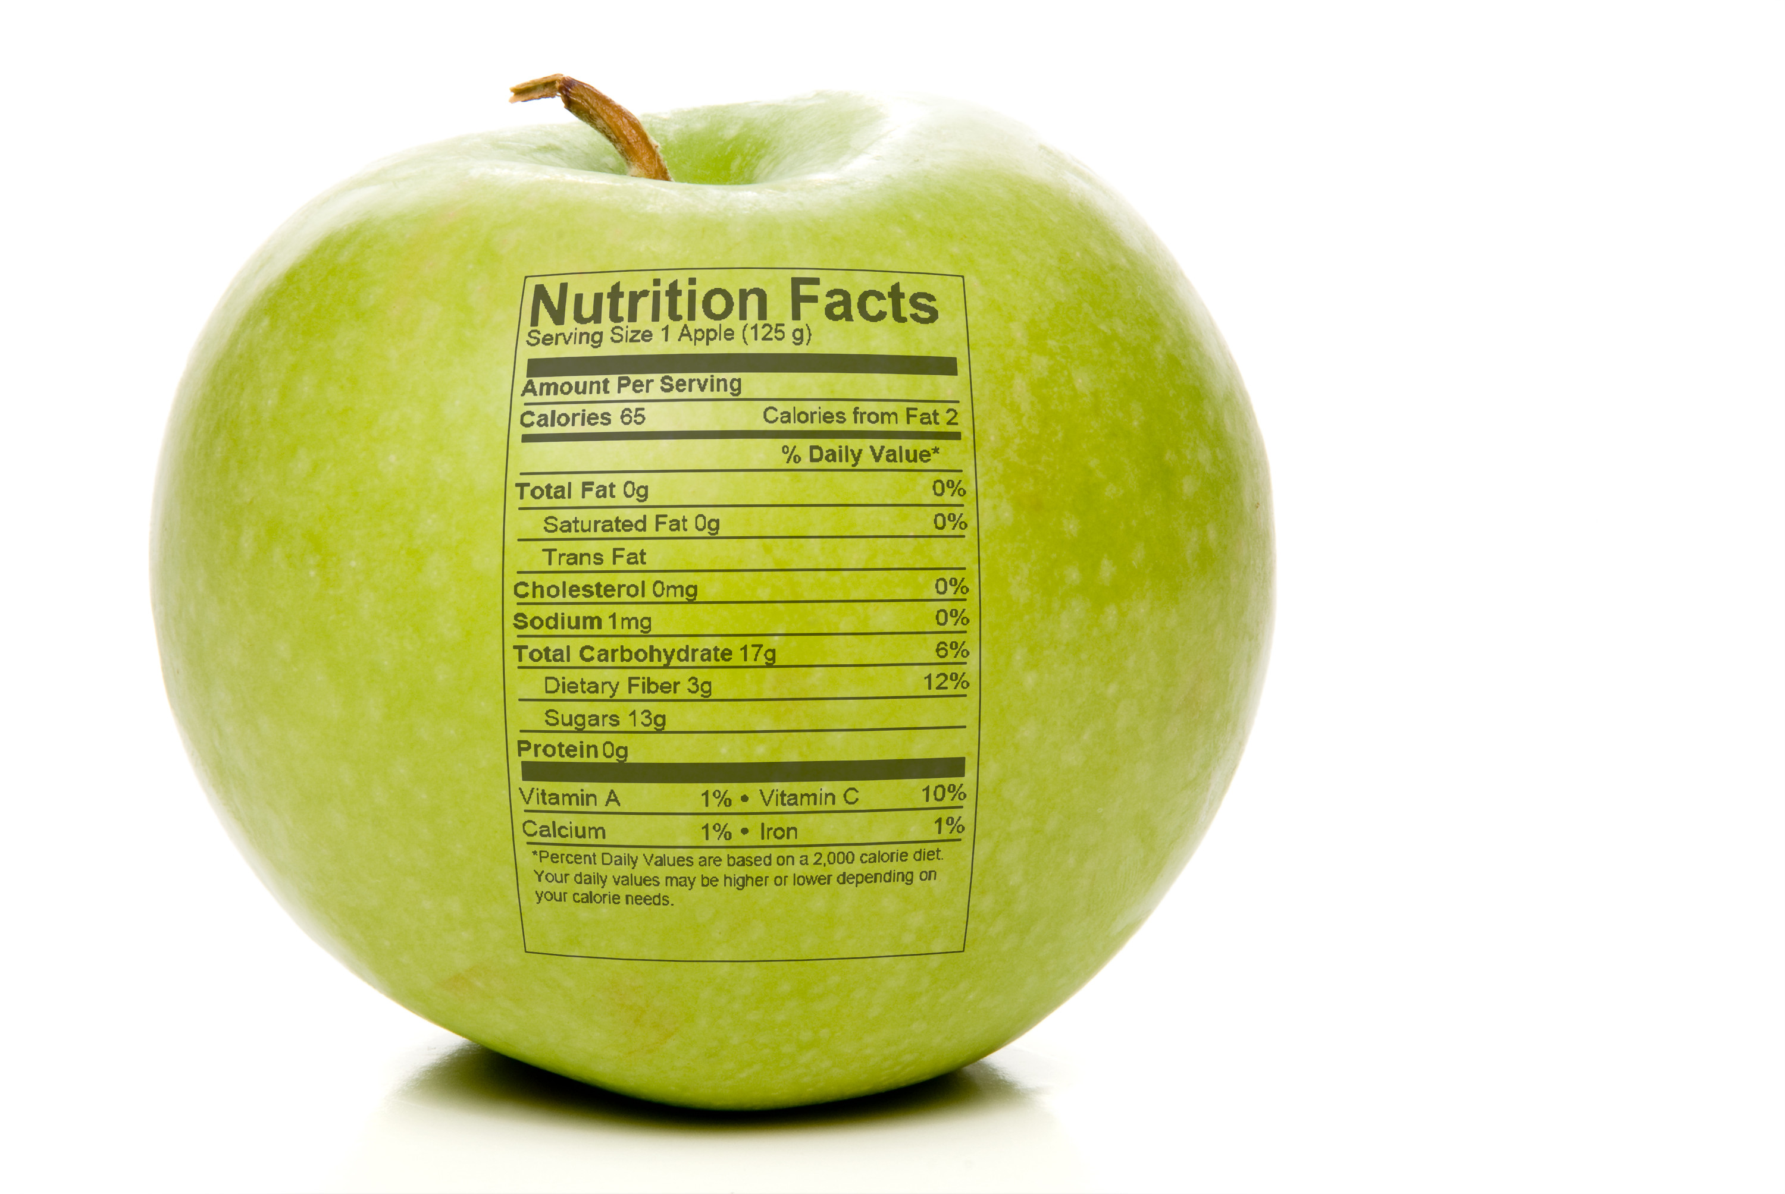
2. Privacy “Nutrition Labels”
What notice design is most effective?
Can people use privacy nutrition labels to find information and compare policies quickly and accurately?

Slide 51
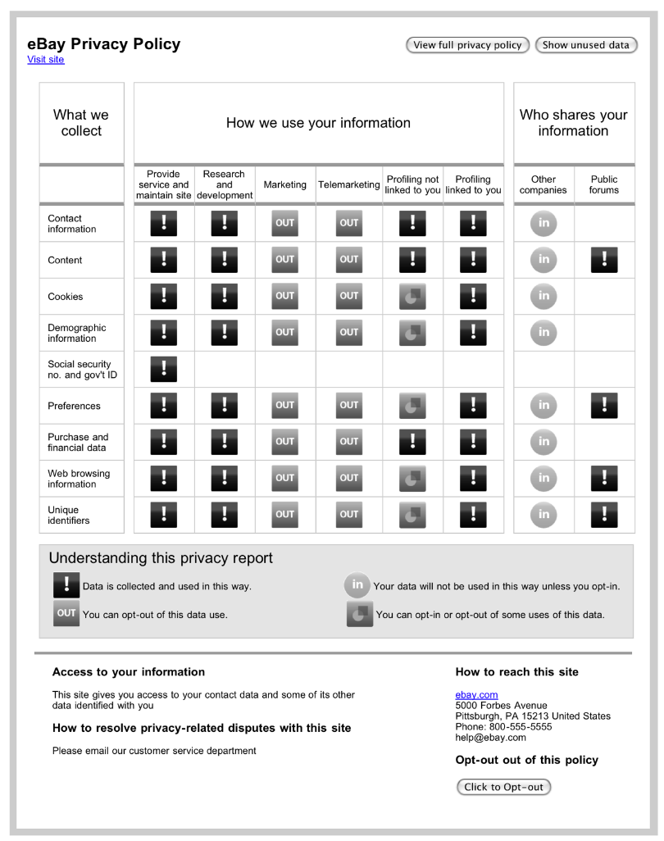



Iterative evaluation
Focus groups
Lab studies
Online studies
P.G. Kelley, L.J. Cesca, J. Bresee, and L.F. Cranor. Standardizing Privacy Notices: An Online Study of the Nutrition Label Approach. CHI2010.

Slide 52

Long and short label versions
Standardized label
Standardized short label

Slide 53


Standardized text version
Short text
Layered text

Slide 54
How do we measure effectiveness?
763 participants, recruited through Amazon’s Mechanical Turk
Between subjects design
–Standardized label
–Standardized short label
–Standardized short text
–Full text
–Layered text
Measured time, accuracy, and enjoyability on information finding and comparison tasks

Slide 55

Which ones more effective?
Short form of notice had better accuracy in general
Table format has slight edge over text

Slide 56

3. Effectiveness of AdChoices icon and taglines
Do people know what the icon/tagline mean?
Do people know what would happen if they clicked on the icon?

Slide 57

AdChoices icon study
1,505 participants
Recruited through Amazon Mechanical Turk
Between subjects online survey
What Do Online Behavioral Advertising Disclosures Communicate to Users? P. Leon, J. Cranshaw, L. Cranor, J. Graves, M. Hastak, B. Ur, G. Xu. WPES 2012

Slide 58


Slide 59


Varied icon and taglines
Tagline
Why did I get this ad?
Interest based ads
AdChoices
Sponsor ads
Learn about your ad choices
Configure ad preferences
‘No tagline’
Why did I see this ad?
Icons

Slide 60

What people think happens if they click?
56%
45%
27%
More ads will pop up
Will take you to a page where you can buy advertisements on this website
Will take you to a page where you can opt out of tailored ads
% who agreed with each statement; some participants agreed with multiple statements

Slide 61
What people think happens if they click?
Configure Ad preference
42%
56%
45%
27%
More ads will pop up
Will take you to a page where you can buy advertisements on this website
Will take you to a page where you can opt out of tailored ads
15%
50%
% who agreed with each statement; some participants agreed with multiple statements

Slide 62
4. Effectiveness of privacy meters in search results
Do privacy meters change purchase behavior?

Slide 63

Search result with privacy meter

Slide 64
How do we test whether privacy meters change behavior?
Hypothetical task
Search for product
Which site would you buy from?
Real task
Search for product
Make purchase with your credit card
Hypothetical
No real privacy tradeoff
Expensive
Difficult to control

Slide 65
First purchasing study had significant limitations
Participants were all students
Reimbursement did not incentivize saving
Price/privacy tradeoff not obvious
Maybe people just like pretty indicators
Privacy-sensitive item not sensitive enough

Slide 66
Study design
72 Pittsburgh residents
Price/privacy tradeoff
Fixed payment
New icons, new products, new conditions
J. Tsai, S. Egelman, L. Cranor, A. Acquisti. The Effect of Online Privacy Information on Purchasing Behavior: An Experimental Study. ISR 2011.

Slide 67


Slide 68

Products used for the experiment
J. Tsai, S. Egelman, L. Cranor, A. Acquisti. The Effect of Online Privacy Information on Purchasing Behavior: An Experimental Study. ISR 2011.

Slide 69

Study to control privacy premium
Needed cooperation of vendors
Contacted 46 battery and sex toy vendors
Convinced 8 to adjust prices for our study
– Asked one to lower prices and promised to pay the difference
– Sent $140 check to The Dirty Bunny for “research project assistance”

Slide 70

Merchant selection
Selected 10 merchants for each product
No well-known merchants
Controlled first four search results: more expensive -> better privacy
$0.69 privacy premium

Slide 71

Privacy information condition

Slide 72

Irrelevant information condition

Slide 73

No information

Slide 74
Do privacy icons influence purchases?
No privacy info:
most people purchased where price was lowest
With privacy info:
more people purchased from expensive sites with better privacy

Slide 75

Sure enough
Privacy-sensitive nature of product impacts willingness to pay a premium for privacy
S. Egelman, J. Tsai, L. Cranor, A. Acquisti. Timing is Everything? The Effects of Timing and Placement of Online Privacy Indicators. CHI 2009

Slide 76
Logistics
Home work 4 due Oct 23 @11:59pm

